Slide 1
Out of Home works for Telecoms brands

Slide 2
Out of Home is a key medium for Telecoms brands

Slide 3
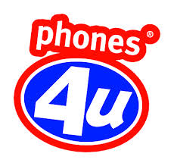
Leading Telecoms brands trust Out of Home
£18.3m
EE
£16.4m
£10.1m
£9.8m
£8.7m
£7.8m
£6.6m
£4.4m
£4.3m
£2.6m
£2.1m
£1.7m
£1.2m
£1.0m
£0.8m

Slide 4
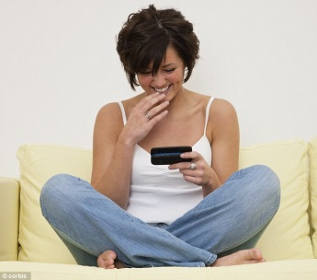
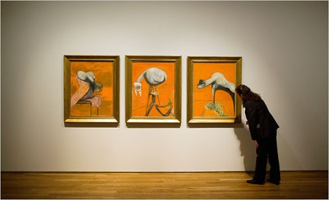
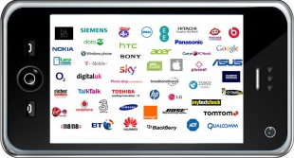
People who see a lot of Out of Home are active and frequent travellers
Heavily opinionated about telecoms products and happy to share their views with others, both off and online
Cultured, and social
Young, in full time
employment, highly
mobile and upscale
HEAVY
OOH CONSUMPTION
Heavy usage mobiles for both personal and business use including downloads (games, music, videos) onto mobiles, shopping, search social media when out and about.
Technophiles willing to invest in latest tech. Brand, image and reputation more important to this audience than cost when selecting landline/mobile networks

Slide 5
Mobility and connectivity is a defining feature of the Out of Home audience
Index
Source: Exterion Media, TGI Media Neutral quintiles 2014
“Heavy” quintile is the 20% of the media audience who consume that medium most, ie the most typical consumer of that medium
Index base All Adults

Slide 6
The Out of Home audience is connected and screen-savvy
Index
Source: Exterion Media, TGI Media Neutral quintiles 2014
“Heavy” quintile is the 20% of the media audience who consume that medium most, ie the most typical consumer of that medium
Index base All Adults

Slide 7
Technology is second nature to the Out of Home audience
Index
Source: Exterion Media, TGI Media Neutral quintiles 2014
“Heavy” quintile is the 20% of the media audience who consume that medium most, ie the most typical consumer of that medium
Index base All Adults

Slide 8
Heavily OOH-exposed people are actively engaged with telecoms
Those heavily exposed to Out of Home are also actively interested in telecoms products and very likely to influence others about telecom products and services
Index
Source: Exterion Media, TGI Media Neutral quintiles 2014
“Heavy” quintile is the 20% of the media audience who consume that medium most, ie the most typical consumer of that medium
Index base All Adults

Slide 9
Out of Home drives telecom search, consideration and purchase
Those seeing OOH ads are more likely to search, learn about companies or purchase products and services they’ve seen advertised, but people in the market for telecom products are even more likely to do so
The Customer Journey 2012
Searched from home/work

Slide 10
Higher exposure to OOH increases search and purchase for telecom products
More exposure to OOH appears to have an effect on online search and purchase, especially at the highest exposure (e.g. 5+ exposures)
The Customer Journey 2012

Slide 11
Being connected is vital for the Out of Home audience
Index
Source: Exterion Media, TGI Media Neutral quintiles 2014
“Heavy” quintile is the 20% of the media audience who consume that medium most, ie the most typical consumer of that medium
Index base All Adults

Slide 12
Heavy mobile phone users are more heavily exposed to OOH than other media
Index
Source: Exterion Media, TGI Media Neutral quintiles 2014
“Heavy” quintile is the 20% of the media audience who consume that medium most, ie the most typical consumer of that medium
Index base All Adults

Slide 13
Out of Home targets high spenders
Index
Source: Exterion Media, TGI Media Neutral quintiles 2014
“Heavy” quintile is the 20% of the media audience who consume that medium most, ie the most typical consumer of that medium
Index base All mobile phone owners

Slide 14
Out of Home audience considers brand before cost for mobile network selection
Index
Source: Exterion Media, TGI Media Neutral quintiles 2014
“Heavy” quintile is the 20% of the media audience who consume that medium most, ie the most typical consumer of that medium
Index base All mobile phone owners / most important factors when selecting a mobile network provider

Slide 15
Out of Home audience considers brand before cost for selecting a landline network
Index
Source: Exterion Media, TGI Media Neutral quintiles 2014
“Heavy” quintile is the 20% of the media audience who consume that medium most, ie the most typical consumer of that medium
Index base All adults / most important factors when selecting a landline network provider

