Slide 1
Out of Home works for Travel brands

Slide 2
Leading Travel & Transport brands trust Out of Home
£5.9m
EE
£4.1m
£3.9m
£2m
£1.9m
£1.8m
£1.6m
£990k
£970k
£920k

Slide 3
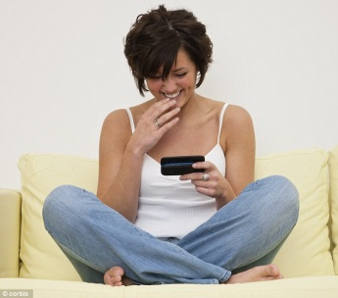
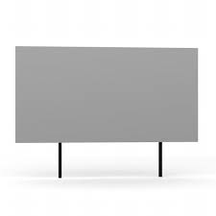
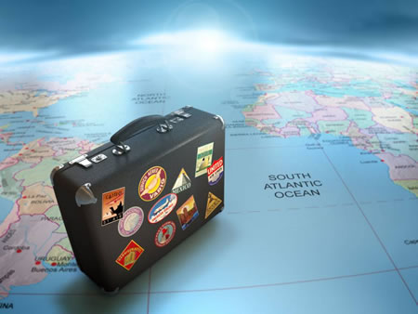
People who see a lot of Out of Home are active and frequent travellers
Actively interested in travel and transport products and happy to share their views with others, both off and online
Young, in full time employment, upscale, high income, mobile,
and active
HEAVY
OOH CONSUMPTION
Travel abroad frequently on both business and leisure and so are actively interested in the sector.
Favoured modes of travel are air and for European-based holidays, car too. Enjoy a mix of holidays, active and beach but have a sense of adventure and like to be pampered.
Regular travellers, active mindset

Slide 4
People heavily exposed to OOH are heavy business and leisure travellers
Index
Source: Exterion Media, TGI Media Neutral quintiles 2014
“Heavy” quintile is the 20% of the media audience who consume that medium most, ie the most typical consumer of that medium
Index base All Adults

Slide 5
People heavily exposed to OOH take a broad range of holidays
Index
Source: Exterion Media, TGI Media Neutral quintiles 2014
“Heavy” quintile is the 20% of the media audience who consume that medium most, ie the most typical consumer of that medium
Index base All Adults

Slide 6
The Heavy Out of Home audience spends more on holidays and short breaks
%
Source: Exterion Media, TGI Media Neutral quintiles 2014
“Heavy” quintile is the 20% of the media audience who consume that medium most, ie the most typical consumer of that medium
Index base All Adults

Slide 7
People who see a lot of OOH are active and frequent travellers
Those heavily exposed to Out of Home like travelling abroad particularly where activities are organised but still have a sense of adventure
Index
Source: Exterion Media, TGI Media Neutral quintiles 2014
“Heavy” quintile is the 20% of the media audience who consume that medium most, ie the most typical consumer of that medium
Index base All Adults

Slide 8
People exposed to lots of OOH have strong emotional connection with Travel
Those heavily exposed to Out of Home are also actively interested in, and very likely to influence others about travel products
Index
Source: Exterion Media, TGI Media Neutral quintiles 2014
“Heavy” quintile is the 20% of the media audience who consume that medium most, ie the most typical consumer of that medium
Index base All Adults

Slide 9
People who see posters for Travel & Transport products are more likely to act
Those seeing OOH ads are more likely to search and learn about companies or products they’ve seen advertised, but people in market for Travel are even more likely to do so
The Customer Journey 2012
Search from home/work

Slide 10
Out of Home drives web search for travel brands, more than TV, press and radio
Mindshare research shows that Out of Home drives web search volume for the advertised brand
Outdoor generates more search than TV, press and radio
Increase in travel brand online search volume caused by £1m advertising.
Source: Mindshare “The Branding Power of Outdoor”
Note: press and radio were found to have negligible effect

Slide 11
Travel and holiday destinations campaigns get noticed with out of home
“Have you seen outdoor advertising for travel and holiday destinations recently?”
Source: YouGov, August 2012
Urban are those who live or work in cities or towns

Slide 12
Over 1/3 of those intending to visit a travel agents have seen OOH in the past 30 mins
Visitors to travel agents, 34% have seen OOH in past 30 minutes
Source: Last Window of Influence study
Base: All Shoppers/Those intending to visit travel agents today

Slide 13
OOH offers best return on investment (ROI analysis of travel campaigns)
Source: BrandScience Travel

