Slide 2
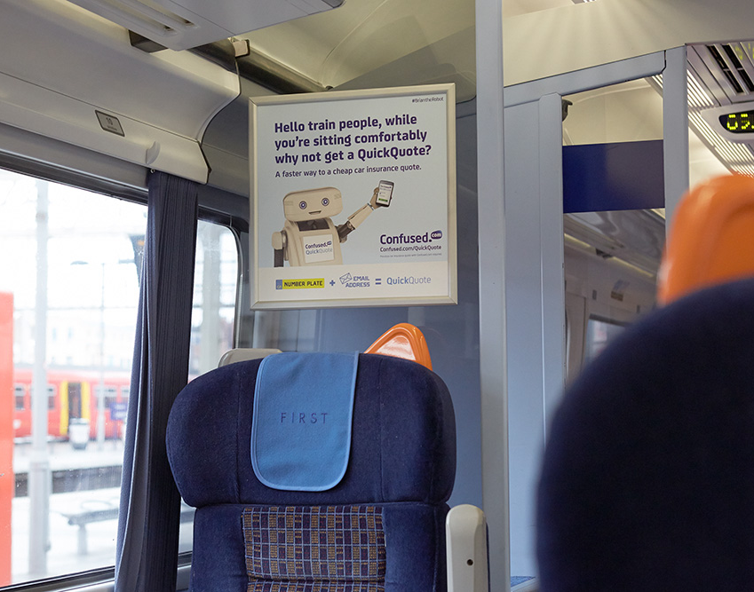
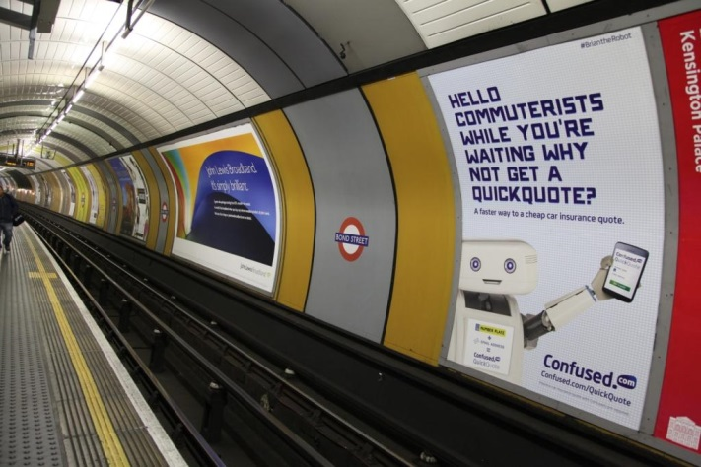
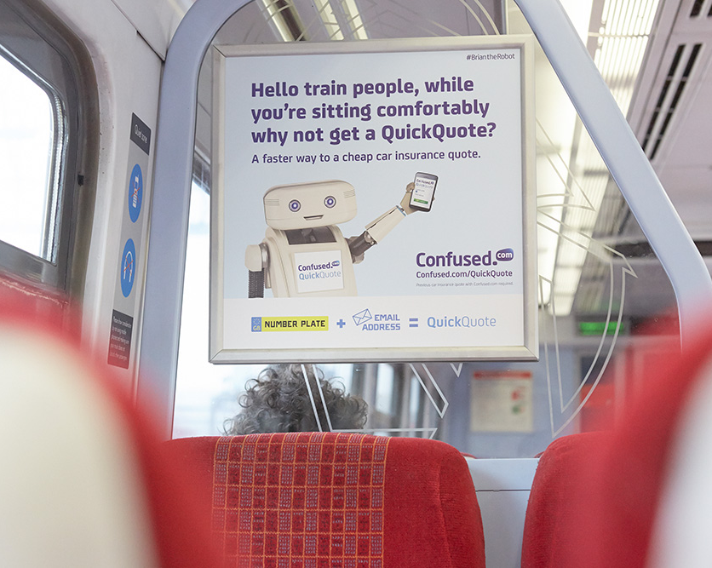
Case study: Confused.com
Confused.com wanted to launch their new branding, welcome their new mascot Brian the Robot and reposition themselves as experts and market leaders. The campaign’s objectives were to reinforce and broaden awareness of Confused.com’s new creative strategy following the launch and promote their new product Quick Quote.
The campaign used TV for the initial launch and Out of Home, both National Rail and London Underground formats, to build brand awareness and familiarity. Confused.com utilised 16 sheets on the Underground and a medium weight Train Card panel campaign. The formats were perfectly placed to capture commuter’s attention at a time when they were receptive to messaging and experiencing long dwell times. 60% of people peopled surveyed said that the Confused.com creative was noticeable and 61% stated that it was informative.
The results were substantial with 51% of all train travellers seeing Confused.com traincards and 66% agreeing that they saw the ad ‘many times’. 60% of those who remembered the traincard campaign would consider buying through Confused.com, highlighting the fact that when consumers are out and about, they are in an active mindset and consequently more inclined to absorb and engage with new messages, even those from a seemingly low interest category like car insurance.

Slide 3
Outsmart
Third Floor
43 Dorset Street
London W1U 7NA
outsmart.org.uk

