Slide 2
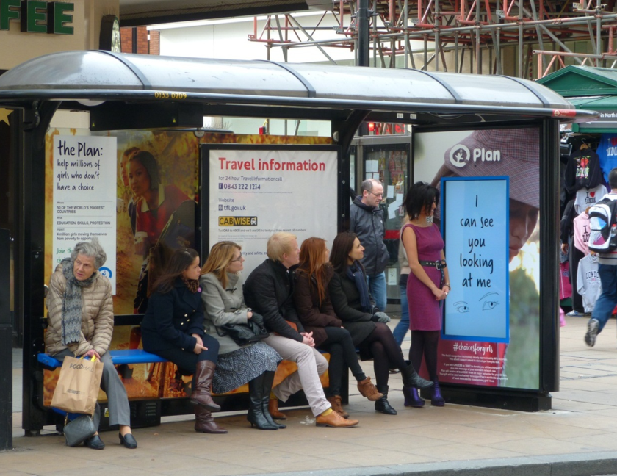
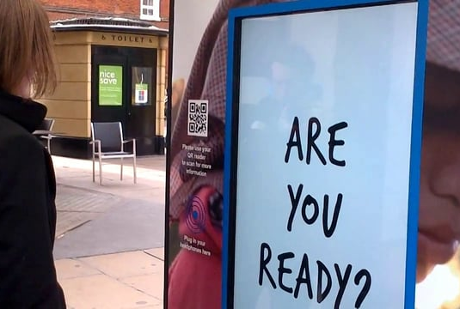
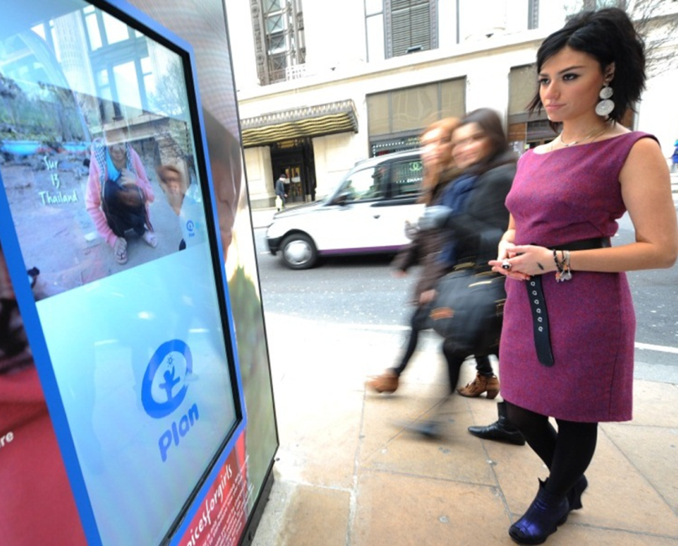
Case study: Plan UK
Plan UK’s objective was to highlight the lack of choices girls in developing nations have, as opposed to those in the UK. As a result, gender recognition technology was used to serve a special 40 second advert to women only.
State-of-the-art facial recognition software & an HD camera were fitted inside a bus shelter 6 sheet to detect the faces of those at the bus stop. The digital screen then displayed a ‘come closer’ message when people looked in its direction. Girls were then able to touch the screen and view the 40 second ad, while males were shown alternative content.
The campaign delivered 340,000 impacts and 27,297 actual viewings over 2 weeks. It gained worldwide press coverage in print, digital and broadcast media. Social media activity drove people to the website as well as encouraged notable celebrities to tweet about the installation. #choicesforgirls was tweeted 40,000 times in launch week.

Slide 3
Outsmart
Third Floor
43 Dorset Street
London W1U 7NA
outsmart.org.uk

