Slide 2
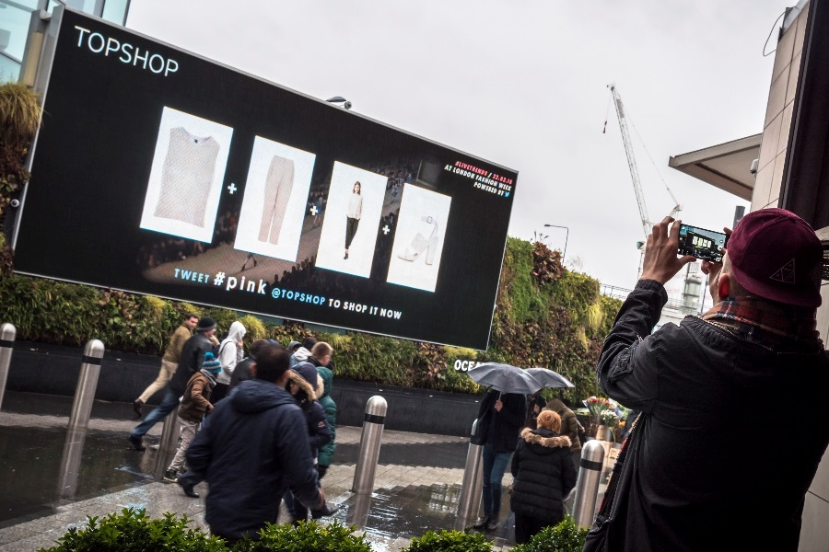
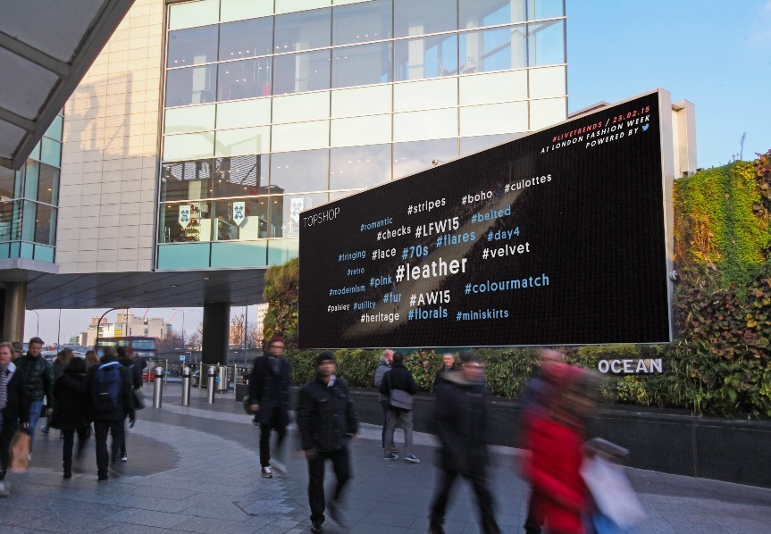
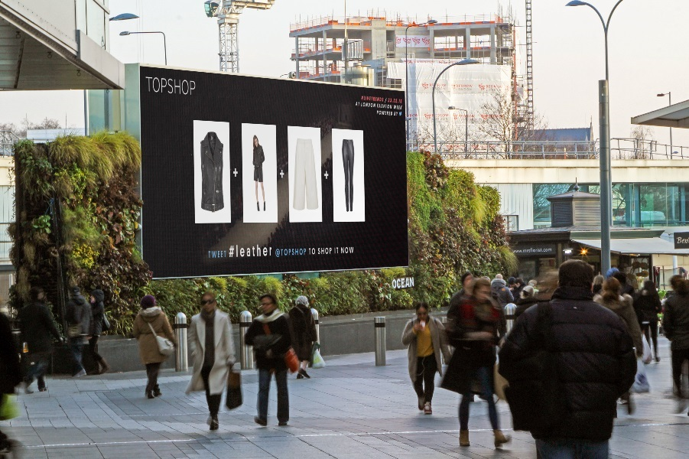
Case study: Topshop
Topshop collaborated with Twitter, Ocean Outdoor and Stackla to turn social media conversations at London Fashion Week into real-time trends shared in the public space.
The digital Out of Home campaign allowed Topshop to showcase #LIVETRENDS as well as scenes directly from the catwalk. Each DOOH site was in close proximity to a Topshop store. The DOOH posters displayed trending topics from the catwalk and prompted customers to tweet the trend to receive a link to the product.
The #LIVETRENDS campaign was a triumph, both in terms of consumer engagement and ROI. More than 3.8 million customers engaged using the hashtag on Twitter. Topshop saw a sales uplift of 75% on products which featured online during the DOOH campaign, contributing to an 11:1 return on its investment.

Slide 3
Outsmart
Third Floor
43 Dorset Street
London W1U 7NA
outsmart.org.uk

