Slide 2
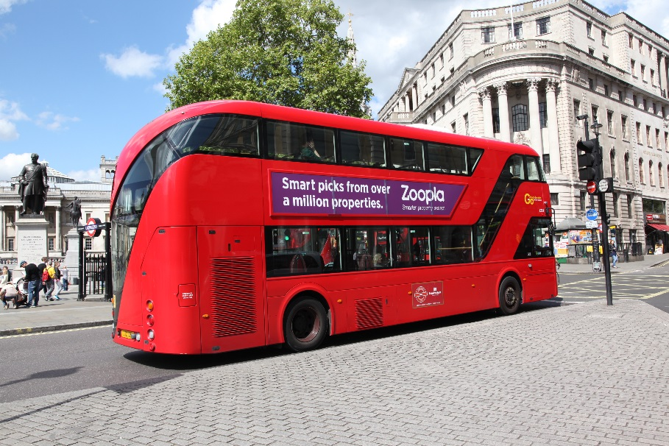
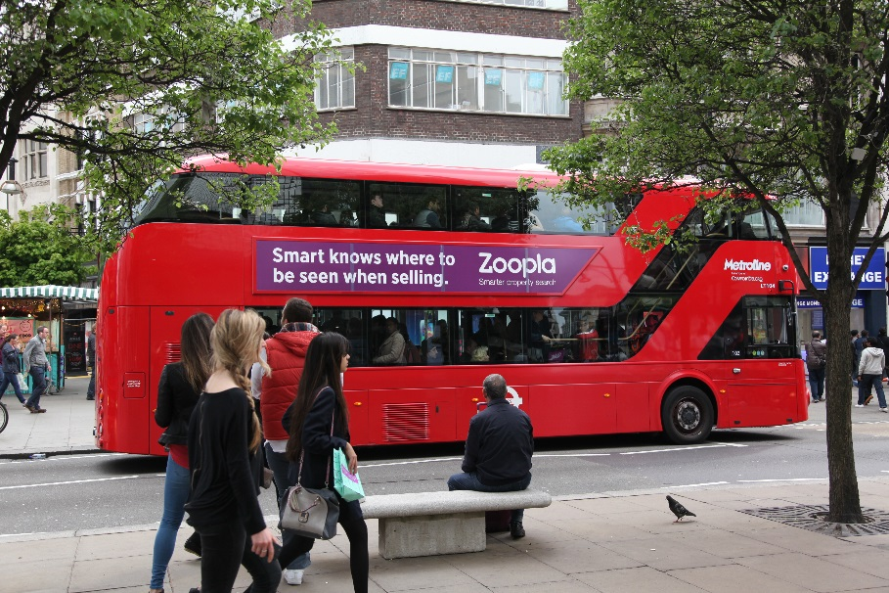
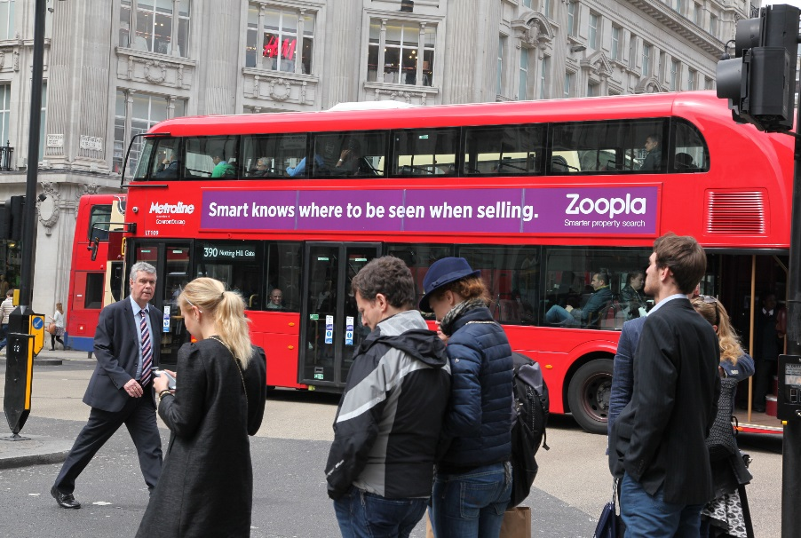
Case study: Zoopla
Zoopla wanted to increase brand awareness and drive traffic online to their website. With the property market rocketing and rival competitors fighting to be the ‘go to’ resource for property information, Zoopla needed to stand out and prove that it was trustworthy.
Zoopla launched an ‘Always On’ strategy to generate top of mind awareness.
The campaign launched on both Routemasters & Supersides across the capital for a 6 month period. In order to measure the effectiveness of the campaign, Exterion Media worked with Dipsticks Research to capture a number of the campaign’s key metrics. To realistically reflect Zoopla’s target audience, the sample was made up as follows; 30% 18-34 year olds, 50% 35-54 year olds, 20% 55 years and over.
Post campaign, awareness of the Zoopla Bus ad increased in line with the level of exposure to the campaign. Furthermore, the Bus ads drove traffic online; demonstrated by the fact that the test group were 65% more likely to search properties online using Zoopla. In addition, 57% of those exposed to the Bus ads recalled Zoopla unprompted, demonstrating the effectiveness of clear campaign messaging.

Slide 3
Outsmart
Third Floor
43 Dorset Street
London W1U 7NA
outsmart.org.uk

