Slide 1
ROI in Out Of Home.
Proving OOH effectiveness in econometrics

Slide 2
Who we’ve been talking to…
Document Title
Date
2

Slide 3
The Agenda.
What is econometric modelling?
What are the challenges for Out of Home Media in econometric modelling?
How can these challenges can be resolved?

Slide 4
What is ‘Econometrics’?
Econometrics takes its name from its original purpose – to ‘understand economies’
Around 30 years ago, UK marketers began to build econometric models to measure the impact of key variables (including advertising) on sales and profit
It’s essentially maths and stats
Crucially, econometric modelling can be refined over long periods of time so that the forecasting can become more accurate

Slide 5
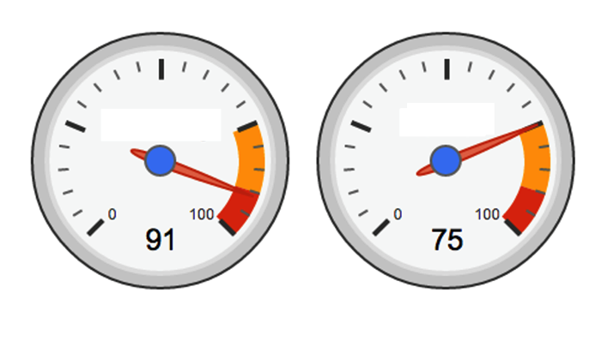
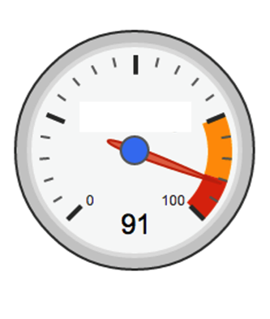
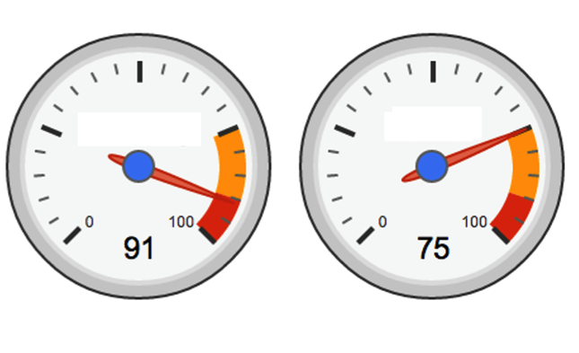
How it works.
Key Brand Drivers
Price
Weather
Competitor Activity
Stock & Distribution
Advertising
90
75
60
85
15
Model
RETURN ON INVESTMENT
Customer Acquisition
Market Share
Sales

Slide 6
Why advertisers use Econometrics.
Levels of
investment
Identifying the
right media mix
Reach &
Frequency
When to advertise

Slide 7
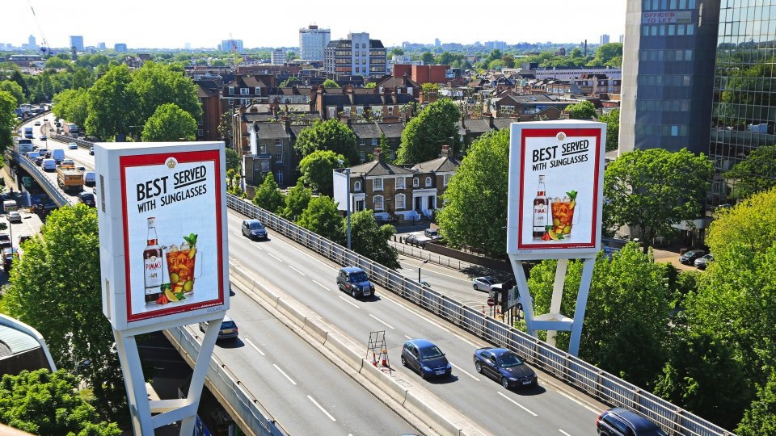
Where OOH fits into econometric modelling.
In advertising, different media channels perform to varying levels within econometric models, and OOH is no different
There is a perception that OOH does not deliver strong ROI within econometric models – although recent smarter uses of the medium have started to combat this
There are many factors as to why this happens, let’s investigate why…
7

Slide 8
The challenges for OOH in econometric modelling.
The creative effect
Lack of data variation
Modelling the
whole
Exclusion
Low Quality Data
Low spend
Source: Outdoor Media Centre Return on Outdoor Investment

Slide 9
Econometric modelling challenges.
The Creative Effect
Q. Did the creative match the ROI metric?
If creative work is less impactful or is principally aimed at brand perception it can impact OOH’s ability to be picked up in models
Modeller view:
“… if the creative is unclear to the consumer, the modelling very often doesn’t work. Other media types have similar issues but they seem to get away with it more than outdoor in terms of modelling.”
Ensure the metric fits the objective - pure ROI as reported by econometric models is not appropriate for creative geared towards driving awareness or image
Best practice guidelines about the creative factors that drive positive ROI for OOH campaigns.
Source: Outdoor Media Centre Return on Outdoor Investment

Slide 10
Econometric modelling challenges.
Modelling The Whole
Q. Was an ROI score produced for each media channel?
Advertisers will often quantify overall past campaign performance rather than produce ROI scores for each channel; especially ones with lower budget levels
Modeller view:
“… clients seem to feel their media mix is generally working and as a result it is difficult to get them to make changes to get OOH modelled with different mixes to help unpick how OOH is performing”.
Invest in production of different media mixes, weights and regional models to provide the critical variation in data.
Source: Outdoor Media Centre Return on Outdoor Investment

Slide 11
Econometric modelling challenges.
Low Quality Data
Q. Was ROUTE used as the main OOH measurement?
There are serious concerns about the quality, accuracy and accessibility of the OOH data used in modelling
Modeller view:
“…the biggest issue is the lack of robust, consistent audience data for posters. The data that we use needs to be more accurate and cover more poster types and formats.”
Incorporation of Route data is essential in the proper evaluation of OOH in econometrics.
We must provide econometricians with Route data.
Also, we must ensure the modelling community are using Route data within their models.
Source: Outdoor Media Centre Return on Outdoor Investment

Slide 12
Econometric modelling challenges.
Lack Of Variation
Q. Was there variation in the OOH data in the model?
Econometric modelling works best when looking at data that has a lot of variations.
OOH spend allocated equally across two week periods (no variation)
The way that most OOH is planned tends to be combined or overlapping with the same other media types
Modeller view:
“… this is a very important issue. There is a big difference between the look of the data that we use for outdoor and TV. TV has much greater variability in it, which is a good thing from a modelling perspective.”
Invest in production of different media mixes, weights and regional models to provide the critical variation in data.
Source: Outdoor Media Centre Return on Outdoor Investment

Slide 13
Econometric modelling challenges.
Exclusion
Q. Was OOH included in the final model?
There are a lot of occasions where OOH does not make it into the final model
Modeller view:
“… you need to make a clear distinction between when you can’t see a read for outdoor and it not working – because you can’t see it doesn’t mean that it is not working!”
Establish if OOH was included into the final model.
Being excluded from a model does not necessarily mean that a medium is not working; just that it could not statistically be separated from the other variables.
Source: Outdoor Media Centre Return on Outdoor Investment

Slide 14
Econometric modelling challenges.
Low Spend
Q. Was the OOH spend high enough to be picked up by the model?
There is frequently low spend or share of spend in the medium
Modeller view:
“… the size of the spend is key to getting a read on the effect of OOH”.
This is something of a ‘chicken-and-egg’ conundrum
When properly measured, OOH delivers good ROI
Learnings about the optimum allocations for delivering ROI via OOH
Source: Outdoor Media Centre Return on Outdoor Investment

Slide 15
Summary: these are the questions to ask
Did the creative execution match the ROI metric?
Was there variation in the OOH data or was it allocated equally across 2 week periods?
Was a ROI score produced for each channel?
Was OOH included in the final model?
Was Route data used as the OOH measurement?
Was the OOH spend high enough to be picked up in the model?
Source: Outdoor Media Centre Return on Outdoor Investment

Slide 16
We need better OOH data…

Slide 17
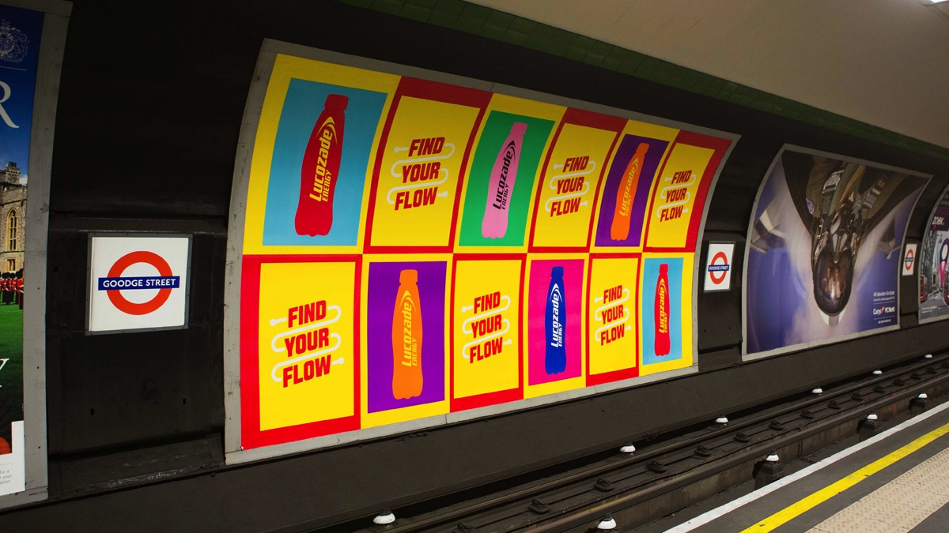
ROUTE: a solution for econometric modellers.
Route was launched in 2013, and is the successor to Postar which had been the OOH audience measurement since 1996
Route produces audience estimates for OOH advertising in the UK, and is the currency in planning, trading and valuing advertising investment in the medium
The data published tells subscribers how many people see an advertising campaign, and how often

Slide 18
ROUTE uses Big Data to measure
Out of Home exposure.
Traffic Intensity Model: determines absolute population numbers & travel flow on every single path
Eye-tracking studies: gauges the likelihood of seeing various forms of display
Inventory Mapping System: collates detailed characteristics of media owners’ frame inventory
GPS Travel Survey: shows how people move around day-to-day

Slide 19
ROUTE enables us to identify more variation in data.
Typical OOH data in Econometric model
ROUTE data in an Econometric model
London
South
East
Central
SW
Wales
North West
Yorkshire
NE
3,000
2,250
GRPs
1,500
750
0
Significantly improves the model’s ability to measure outputs from OOH campaigns

Slide 20
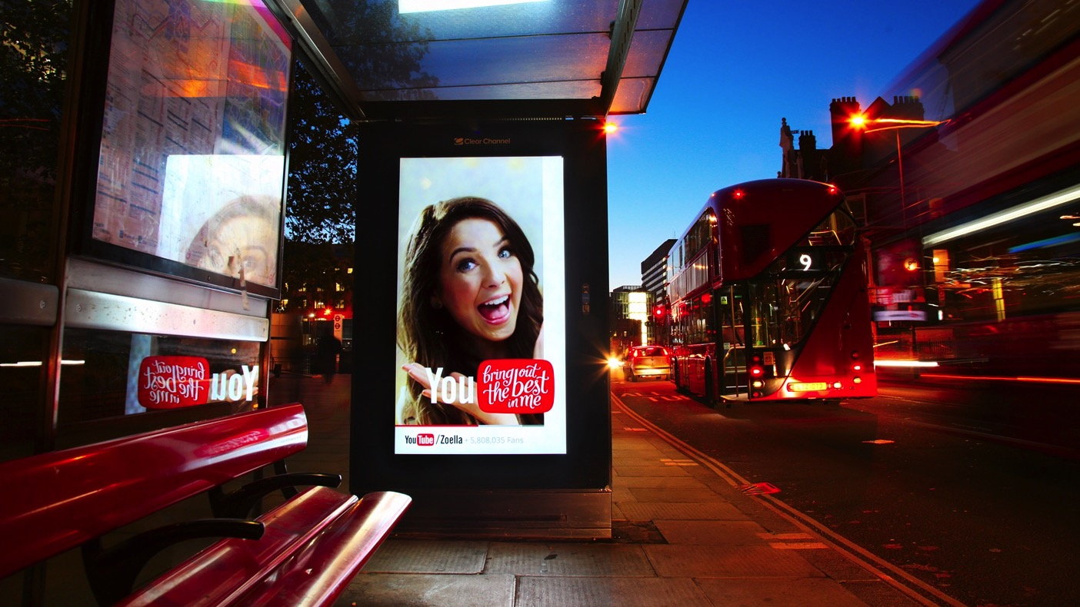
New case studies, using ROUTE data, are arriving all the time…

Slide 21
Talon & Brand Science meta data study –
Methodology
Focused on 211 campaigns
160 campaigns with OOH in the mix
Campaigns were live between 2012-15
Most campaigns used ROUTE data for OOH measurement

Slide 22
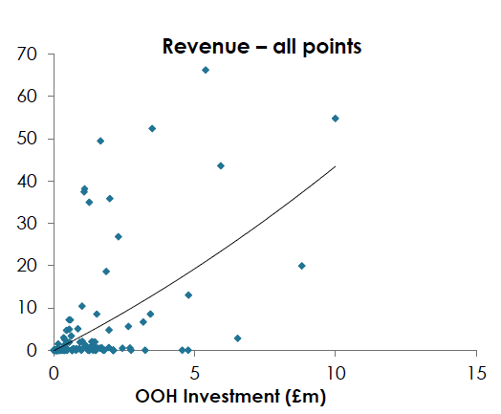
Talon/Brand Science research – there is high variation in OOH campaigns.
Revenue (£m)

Slide 23
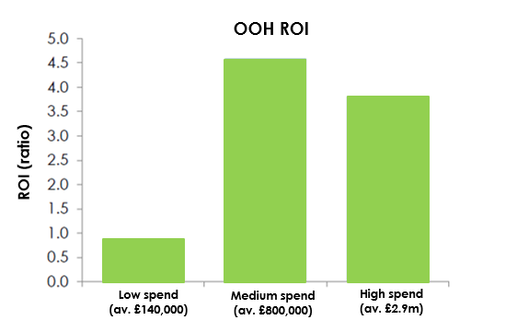
Talon & Brand Science Research – when properly measured OOH delivers strong ROI performance.

Slide 24
All media channels, except radio, improve ROI when OOH is in the mix.

Slide 25
FMCG: All media channels, including radio, improve ROI when OOH is in the mix.

Slide 26
The key takeaways.
When measured properly OOH increases ROI for advertisers and improves ROI for other media channels
Route data is something we can push in the short term to improve measurement
We all need to challenge the old idea that OOH does not perform well in econometric modelling, by asking questions.

Slide 27
Thank you.
Document Title
27

