Slide 1
Why Out of Home works for drinks brands

Slide 2
Out of Home is a key medium for Drinks brands

Slide 3
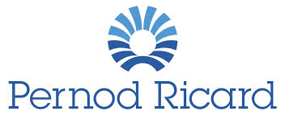
Leading Drinks brands trust Out of Home
£11.7m
£8.7m
£5.5m
£4.8m
£4.4m
£1.2m
£1.1m

Slide 4
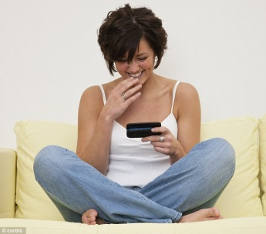
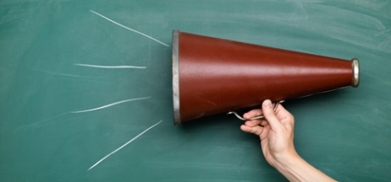
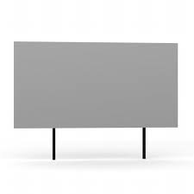
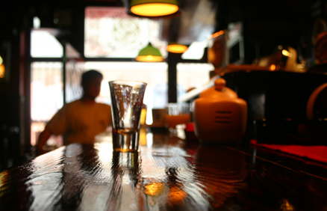
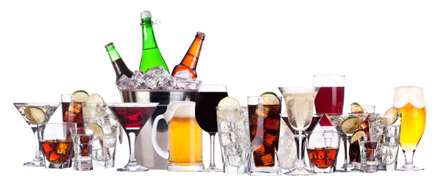
People who see a lot of Out of Home are actively interested in drinks brands
Actively interested in drinks products and happy to share their views with others, both off and online
Young, in full time
employment, upscale,
high income, mobile,
active and highly social
HEAVY
OOH CONSUMPTION
Highly social and enjoy drinking with friends, in home but particularly out in bars, pubs, clubs
Heavy consumers of drinks – spirits, beers, lagers and wines. Happy to pay for quality and open to trying new drinks and brands and have a particularly broad repertoire of brands compared to other media

Slide 5
People who see a lot of posters have strong emotional sector connection
Those heavily exposed to Out of Home are also actively interested in, and very likely to influence others about drinks products
Index
123
Source: Exterion Media, TGI Media Neutral quintiles 2014
“Heavy” quintile is the 20% of the media audience who consume that medium most, ie the most typical consumer of that medium
Index base All Adults

Slide 6
People who see posters for Spirits products are more likely to act
Those seeing OOH ads are more likely to search and learn about companies or products they’ve seen advertised, but people in market for spirits are even more likely to do so
The Customer Journey 2012
Search from home/work

Slide 7
For those in the Spirits market, more OOH means more search and purchasing
The Customer Journey 2012
Search from home/work

Slide 8
Out of Home audiences are social drinkers with broad brand repertoire
Index
Source: Exterion Media, TGI Media Neutral quintiles 2014
“Heavy” quintile is the 20% of the media audience who consume that medium most, ie the most typical consumer of that medium
Index base All Adults / out of home drinking eg pubs, clubs, bars

Slide 9
People who see a lot of OOH are heavy consumers – in and out of home
Those heavily exposed to Out of Home are also heavy consumers of beers, lagers and ciders – both in and out of the home
Index
Source: Exterion Media, TGI Media Neutral quintiles 2014
“Heavy” quintile is the 20% of the media audience who consume that medium most, ie the most typical consumer of that medium
Index base All Adults / in and out of home consumption

Slide 10
People who see a lot of OOH are heavy consumers – in and out of home
Those heavily exposed to Out of Home are also heavy consumers of spirits brands
Index
Source: Exterion Media, TGI Media Neutral quintiles 2014
“Heavy” quintile is the 20% of the media audience who consume that medium most, ie the most typical consumer of that medium
Index base All Adults / heavy consumers ‘elsewhere’

Slide 11
People who see a lot of Out of Home are happy to pay more for quality
Index
Source: Exterion Media, TGI Media Neutral quintiles 2014
“Heavy” quintile is the 20% of the media audience who consume that medium most, ie the most typical consumer of that medium
Index base All Adults / out of home drinking eg pubs, clubs, bars

Slide 12
If production costs are included, OOH is the most efficient medium for FMCG brands
Revenue return on investment, all media, FMCG
Sample Set: All FMCG Results Vault studies with measured Outdoor RROI

