Slide 1
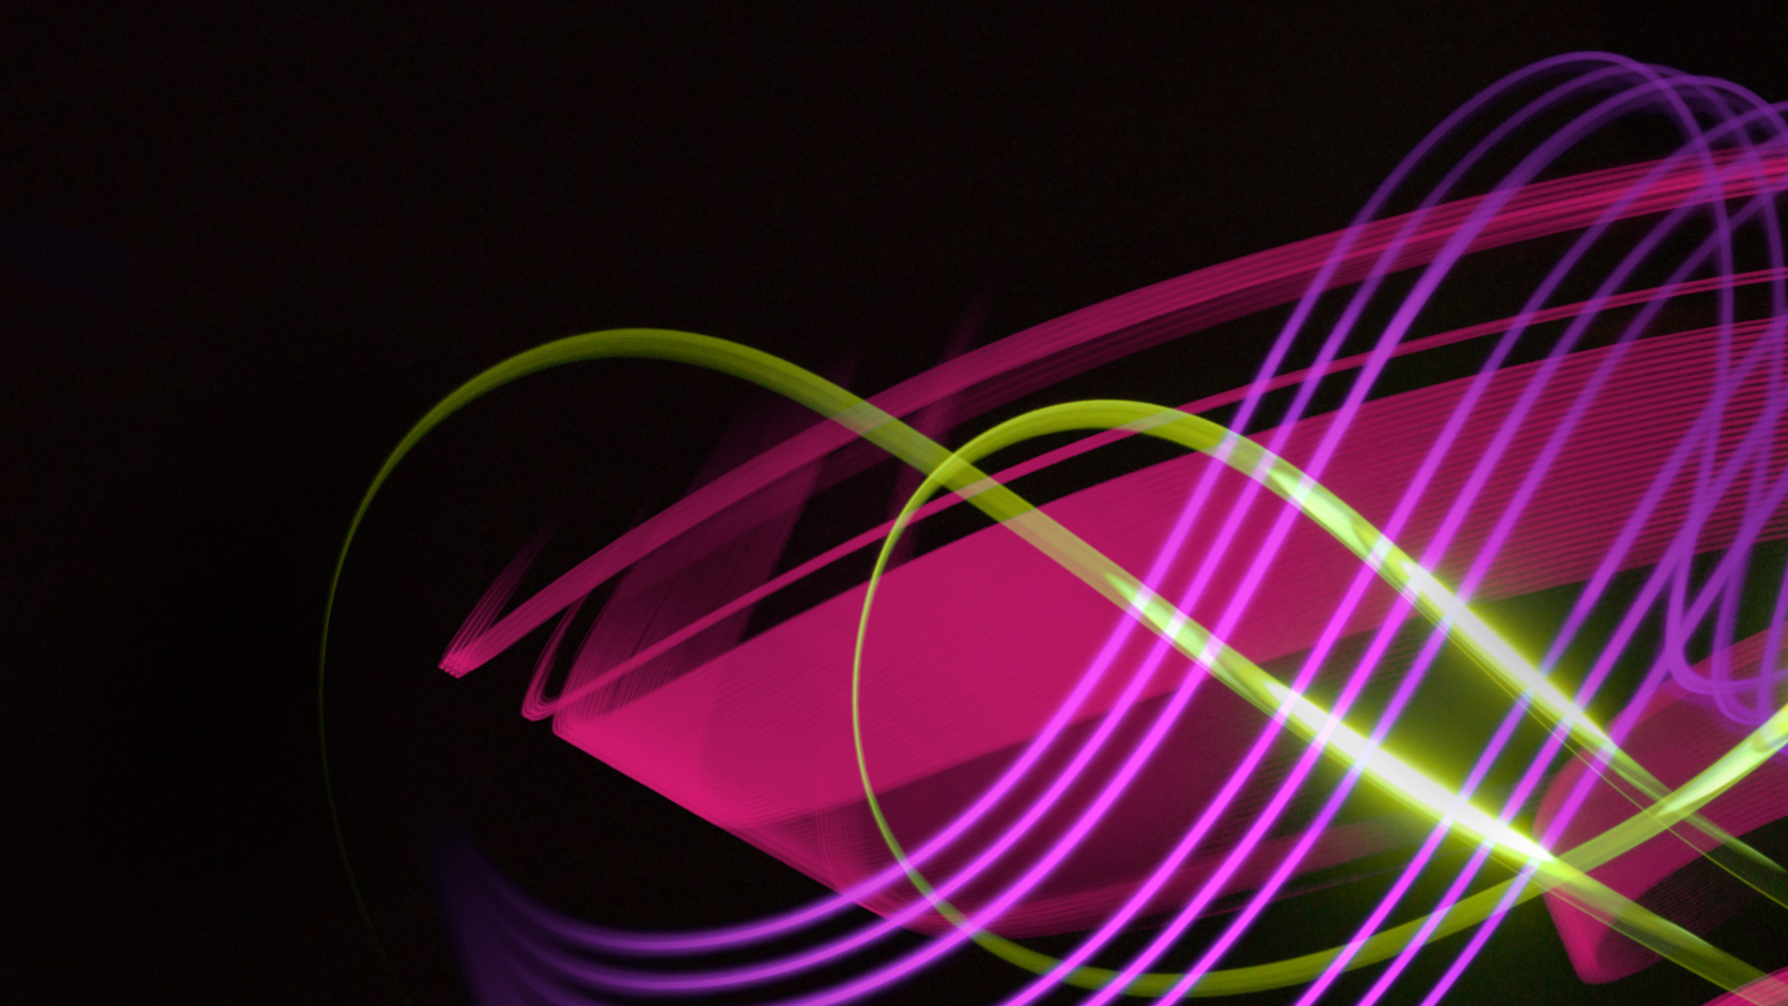
Why Out of Home works for Clothing and Accessories brands

Slide 2
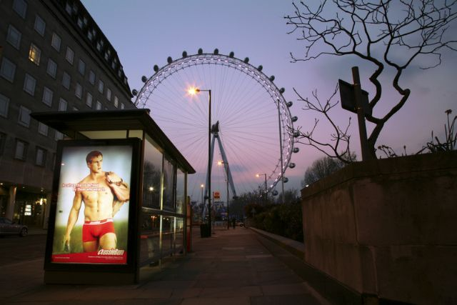
The OOH audience are interested in looking and feeling good
Heavy OOH Definitely / Tend to agree with….
  “ I like to stand out in a crowd” (116)
  “Important to be attractive to the opposite sex” (113)
  “I wear designer clothes” (112)
  “I buy new products before most of my friends” (111)
  “I have expensive tastes” (109)
  “I spend a lot on clothes” (109)
  “It’s worth paying extra for quality” (106)
  “Sometimes treat myself to something I don’t need” (105)
Source: TGI 2013/CBS Top Indexing Lifestyle statements (DA/TA)

Slide 3
OOH-exposed people are more likely to act on ads, this is even more marked for those in the fashion market
People in the market for fashion items are more likely to look at products and services or learn about them compared to the level seen ‘across all products’
Across all products
People in the fashion market
Notes:
Q16

Slide 4
People in the fashion market are more likely to search at home and on mobiles
Across all products, 58% of people have searched for a company, product or service at home or at work because of the outdoor advertising they saw for it, and this rises to 68% for people in the fashion market
Across all products
People in the fashion market
Notes:
Q18

Slide 5
The Out of Home audience is most likely to influence others about fashion
Across all products, 58% of people have searched for a company, product or service at home or at work because of the outdoor advertising they saw for it, and this rises to 68% for people in the fashion market
"Very/Quite likely to influence others about fashion"
Source: Exterion Media, TGI Media Neutral quintiles 2013
“Heavy” quintile is the 20% of the media audience who consume that medium most, ie the most typical consumer of that medium

Slide 6
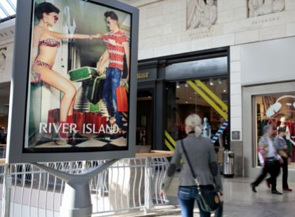
OOH influences purchase
88% had seen and recalled OOH advertising in the 30 mins preceding shopping
Only 13% are not susceptible to the Last Window of Influence
12% who are aware of OOH agree that posters make them want to buy the product
Source: OMC Last window of influence (2011)

Slide 7
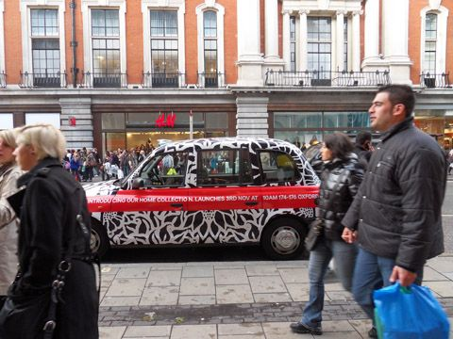
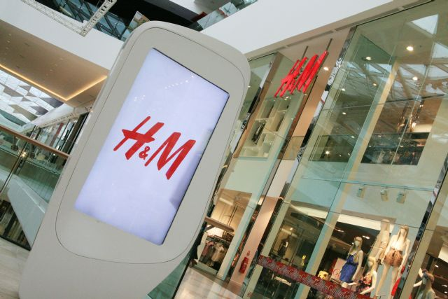
Close proximity to point of sale

Slide 8
Leading fashion advertisers trust Out of Home
Top spending 40 fashion advertisers in outdoor (average spend £346K)
Tesco, Asda , Pandora Jewellery, Lvmh, Adidas, Nike, Burberry, Swatch, Converse, Clarks, Swarovski, Missguided, John Lewis, Vans, New Look, Boux Avenue, Jd Sports, Levi Strauss, Mango, Seiko, Catalyst, H Samuel, Baume & Mercier, Kurt Geiger, Evans, Amg Footwear, Kipling Bags, Hermes, Swico, Victoria's Secret, Sainsbury's, Gucci, Benetton, Juicy Couture, Laing The Jeweller, Bvlgari, Casio, Wl Gore, Zadig & Voltaire, Blacks
Source: Nielsen Media Research 2013

