Slide 1
Why Out of Home works for Financial brands

Slide 2
Financial services advertising is of most interest to 18-44s
Index: Age Groups vs All Adults – Interested in financial services advertising
e.g. 18-24s are 21% more likely to be interested in financial services advertising compared to all UK Adults
Index vs All Adults
Source: TGI Q2 2016 (Base: All Adults)

Slide 3
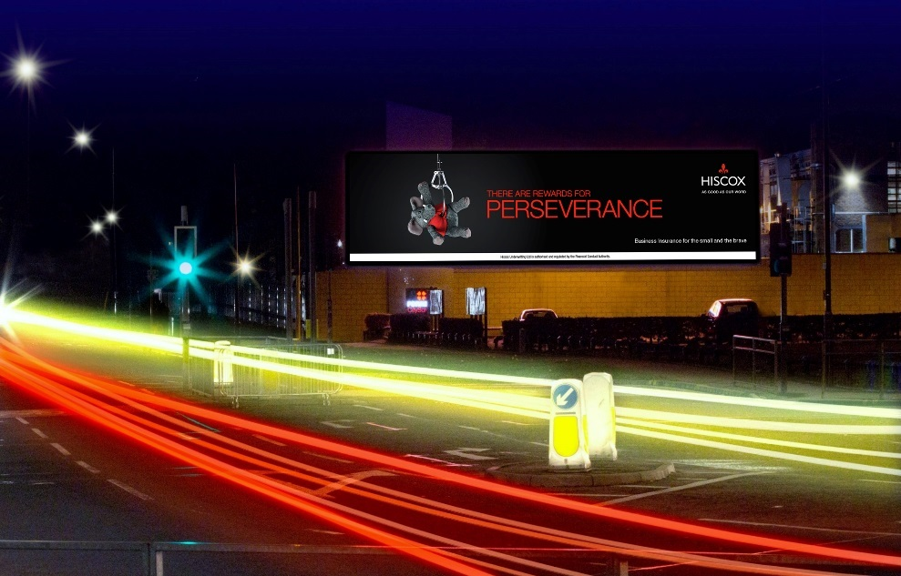
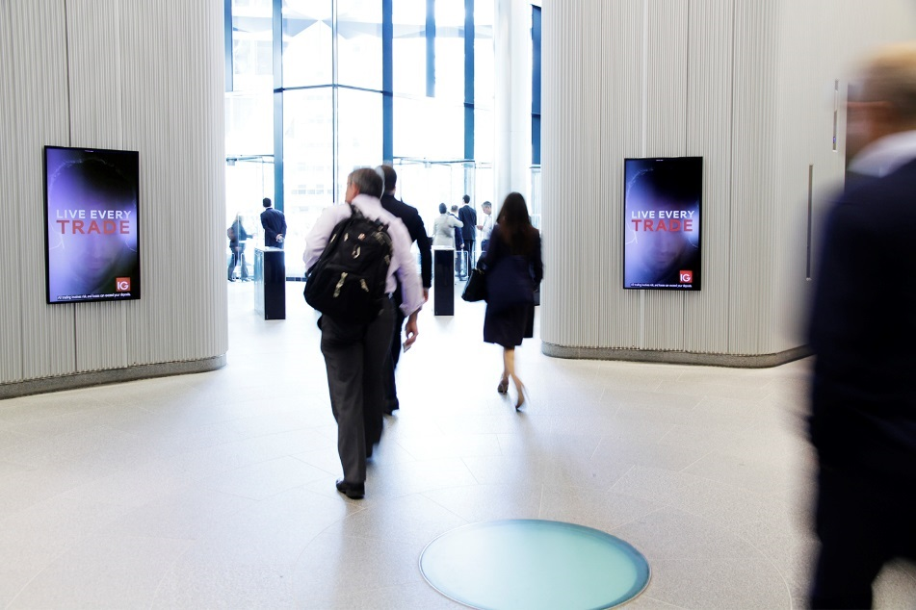
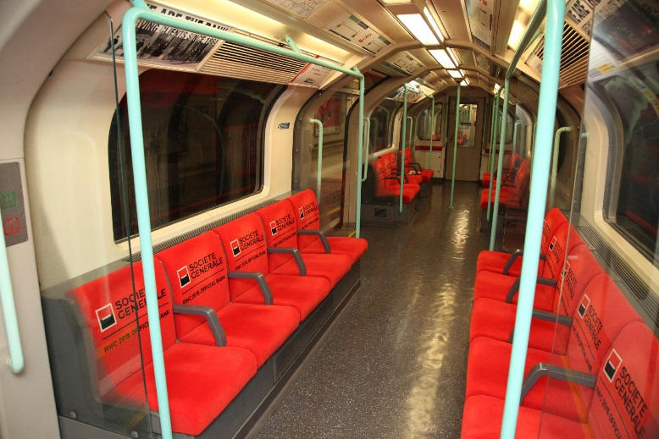
Out of Home advertising enables financial brands to deliver…
Bold branding campaigns
Targeted executions
Creative solutions

Slide 4
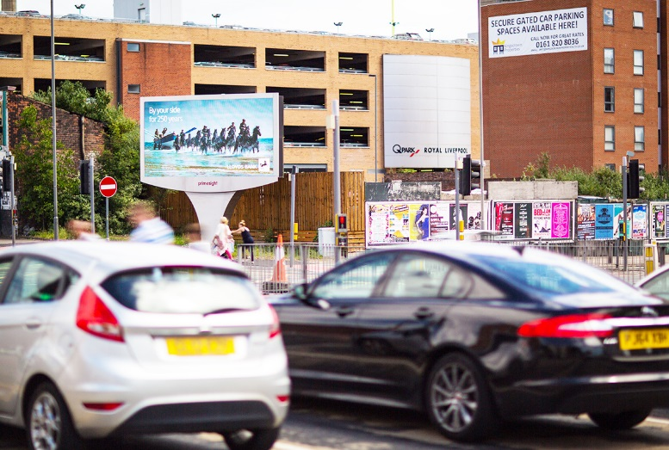
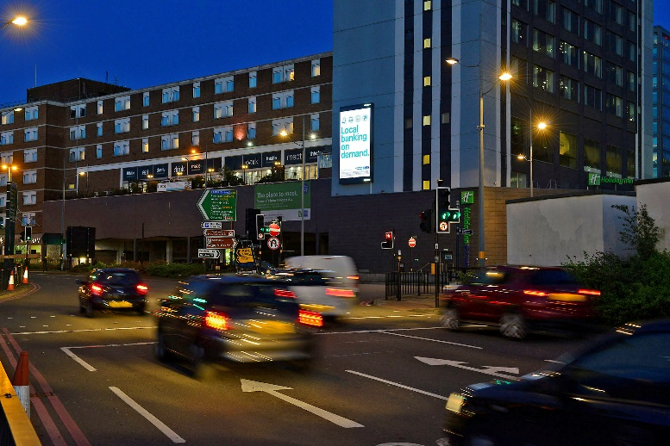
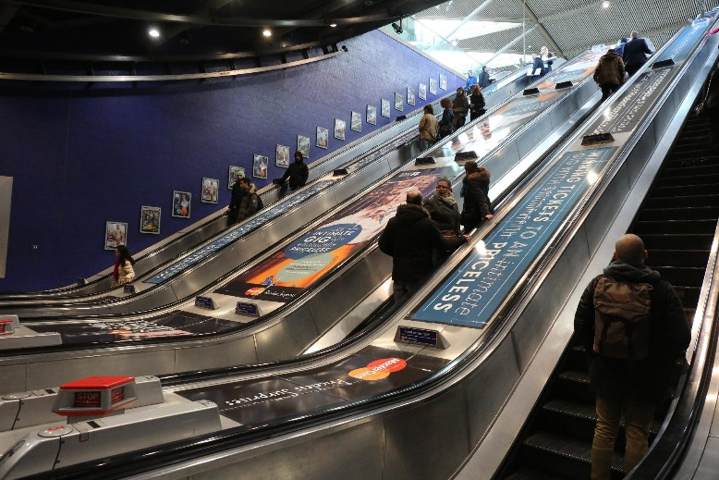
OOH combines brand-building scale with an audience who actively responds
76% of UK 18-44 ABC1s see Out of Home advertising every week
3 hrs is the average amount of time that
UK adults spend ‘out and about’
every day
51% of UK 18-44 ABC1s have responded to seeing an advertisement on Out of Home media
Source: TGI Q2 2016 (Base: All Adults 18+) / ROUTE

Slide 5
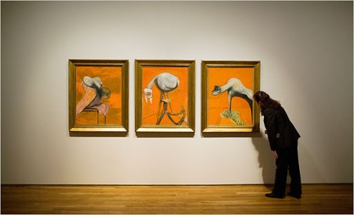
People who see a lot of posters are financially engaged
Extremely well informed about financial products and services and happy to talk about and share their views with others, both off and online
HEAVY
OOH CONSUMPTION
Young, in full time
employment, high
income and upmarket
Educated and cultured
Most likely to have private medical insurance, invested money in their own business, interested in saving but use credit cards/loans when necessary and are most regular uses of online banking
Mobile connected
and actively
interested in
financial products

Slide 6
Heavy OOH consumers are an audience which is involved in financial matters
26%
More likely to regularly purchase financial
products online
21%
Often look for profitable ways to invest their money
(Index 109)
23%
Are interested in financial services advertising
(Index 115)
Source: TGI Q2 2016 (Base: All Adults)

Slide 7
Heavy OOH consumers are also more likely to be key influencers for Finance brands
Index: Heavy media consumers vs Influencers (Word of Mouth) for finance brands
e.g. Heavy OOH consumers are 41% more likely to be finance influencers compared to all UK Adults
Index vs All Adults
‘Heavy’ quintile is the 20% of the media audience who consume that medium most, i.e. the most typical consumer of that medium
Source: TGI Q2 2016 (Base: All Adults)

Slide 8
OOH is strong medium in reaching people who are likely to convince others about financial brands
Index: Heavy media consumers vs likely to convince others about financial brands
e.g. Heavy OOH consumers 22% more likely to be likely to convince others about financial brands, compared to all UK Adults
Over 3 million
UK Adults say that a personal recommendation
is the most important criteria in choosing bank accounts
Index vs All Adults
‘Heavy’ quintile is the 20% of the media audience who consume that medium most, i.e. the most typical consumer of that medium
Source: TGI Q2 2016 (Base: All Adults)

Slide 9
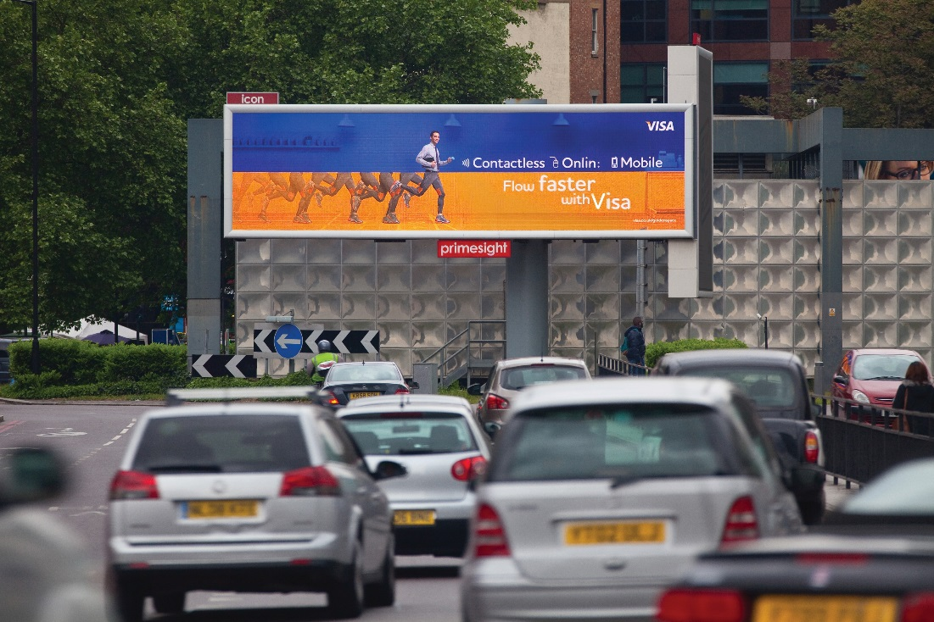
OOH is one of the most trusted media channels according to consumers
Trust is an important element for financial brands
Source: FEPE 2014

Slide 10
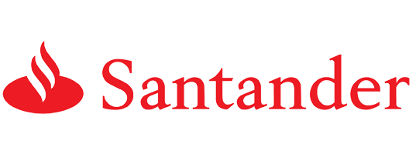
Leading finance brands are big spenders on OOH
Biggest spending Finance brands on OOH in 2015
£7.6m
£7.3m
£6.1m
£4.2m
£3.6m
£3.2m
£2.4m
£2.4m
Source: Nielsen Addynamix – All financial spend Jan-Dec 2015

