Slide 1
Out of Home works for Food & Soft Drinks brands

Slide 2
Out of Home is a key medium for Food & Soft Drink brands

Slide 3
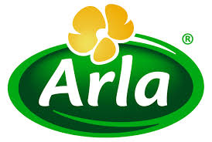
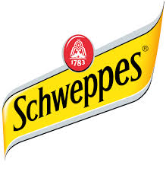
Leading Food & Soft Drink brands trust Out of Home
£8.8m
EE
£5.5m
£4.5m
£4.1m
£3.8m
£3.4m
£2.9m
£2.7m
£2.2m
£1.2m
£1.1m
£1.1m
£0.9m
£0.9m
£0.9m

Slide 4
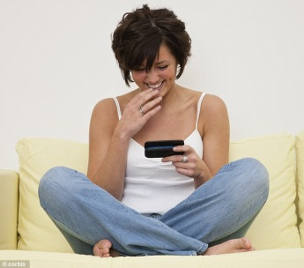
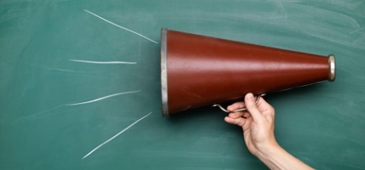
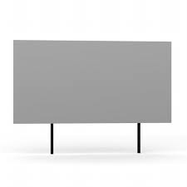
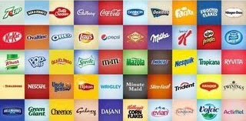
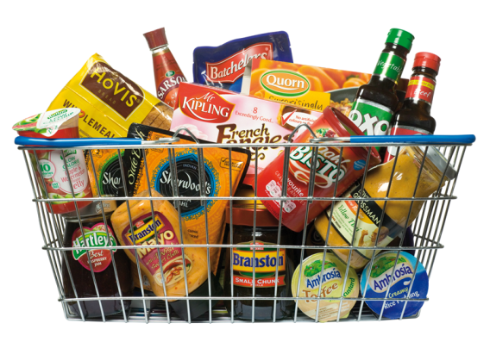
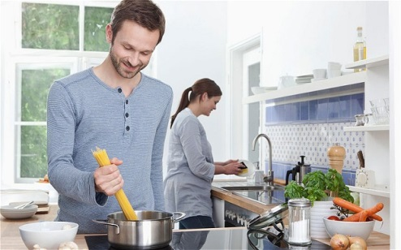
People who see a lot of Out of Home are actively interested in food and brands
Actively interested in food products and happy to share their views with others, both off and online (particularly ‘male main shoppers’)
Young, in full time
employment, upscale,
high income, active
and highly mobile
HEAVY
OOH CONSUMPTION
Trust, loyal to and influenced by brands
Spend a large amount on food, high likelihood to spend on organic and Fairtrade – but are also highly mobile so above average purchasers of snack foods (chocolate, energy bars, bottled water and crisps) and high frequency top up shoppers. Main male shoppers exposed to a lot of OOH tend to be very health conscious shoppers
Get a lot of pleasure
out of food, are adventurous, like to try new foods, and given time to prepare own food

Slide 5
More mobile people make more frequent shopping trips
Go ‘top up’ food shopping on way home from work twice a week or more
Source: Mobile Pound Research, Dipsticks Research Base: 1100 London interviews
Notes:
Since they are out and about more, it’s no surprise that they make more total shopping trips too. Almost half the heavily mobile group, male and female, top up their home grocery shopping by visiting the shops twice a week or more. It looks as if their likelihood to shop is directly affected by their availability to shop. Good news for shops!

Slide 6
People who see a lot of posters have strong emotional connection with Food
Those heavily exposed to Out of Home are also actively interested in, and very likely to influence others about food & drink products
%
Index
84%
Source: Exterion Media, TGI Media Neutral quintiles 2014
“Heavy” quintile is the 20% of the media audience who consume that medium most, ie the most typical consumer of that medium
Index base Main Shopper

Slide 7
The Out of Home audience is interested in food and open to suggestion
Index
Source: Exterion Media, TGI Media Neutral quintiles 2014
“Heavy” quintile is the 20% of the media audience who consume that medium most, ie the most typical consumer of that medium
Index base Main Shopper

Slide 8
The Out of Home audience is a ready-made large audience for foods and snacks
Index
Source: Exterion Media, TGI Media Neutral quintiles 2014
“Heavy” quintile is the 20% of the media audience who consume that medium most, ie the most typical consumer of that medium
Index base Main Shopper

Slide 9
Out of Home is the medium experienced most recently before shopping
Recency is a big driver of ad recall and influence
Outdoor is overwhelmingly the medium shoppers recall seeing or hearing most recently
Source: ‘Last Window of Influence’ study, recalled advertising in last 30 minutes

Slide 10
Out of Home is the medium experienced most recently before shopping
Index
Proximity and recency have an even greater influence on products such as fast food
Source: ‘Last Window of Influence’ study, recalled advertising in last 30 minutes / Index Base All Shoppers

Slide 11
If production costs are included, OOH is the most efficient medium for FMCG brands
Revenue return on investment, all media, FMCG
Sample Set: All FMCG Results Vault studies with measured Outdoor RROI

