Slide 1
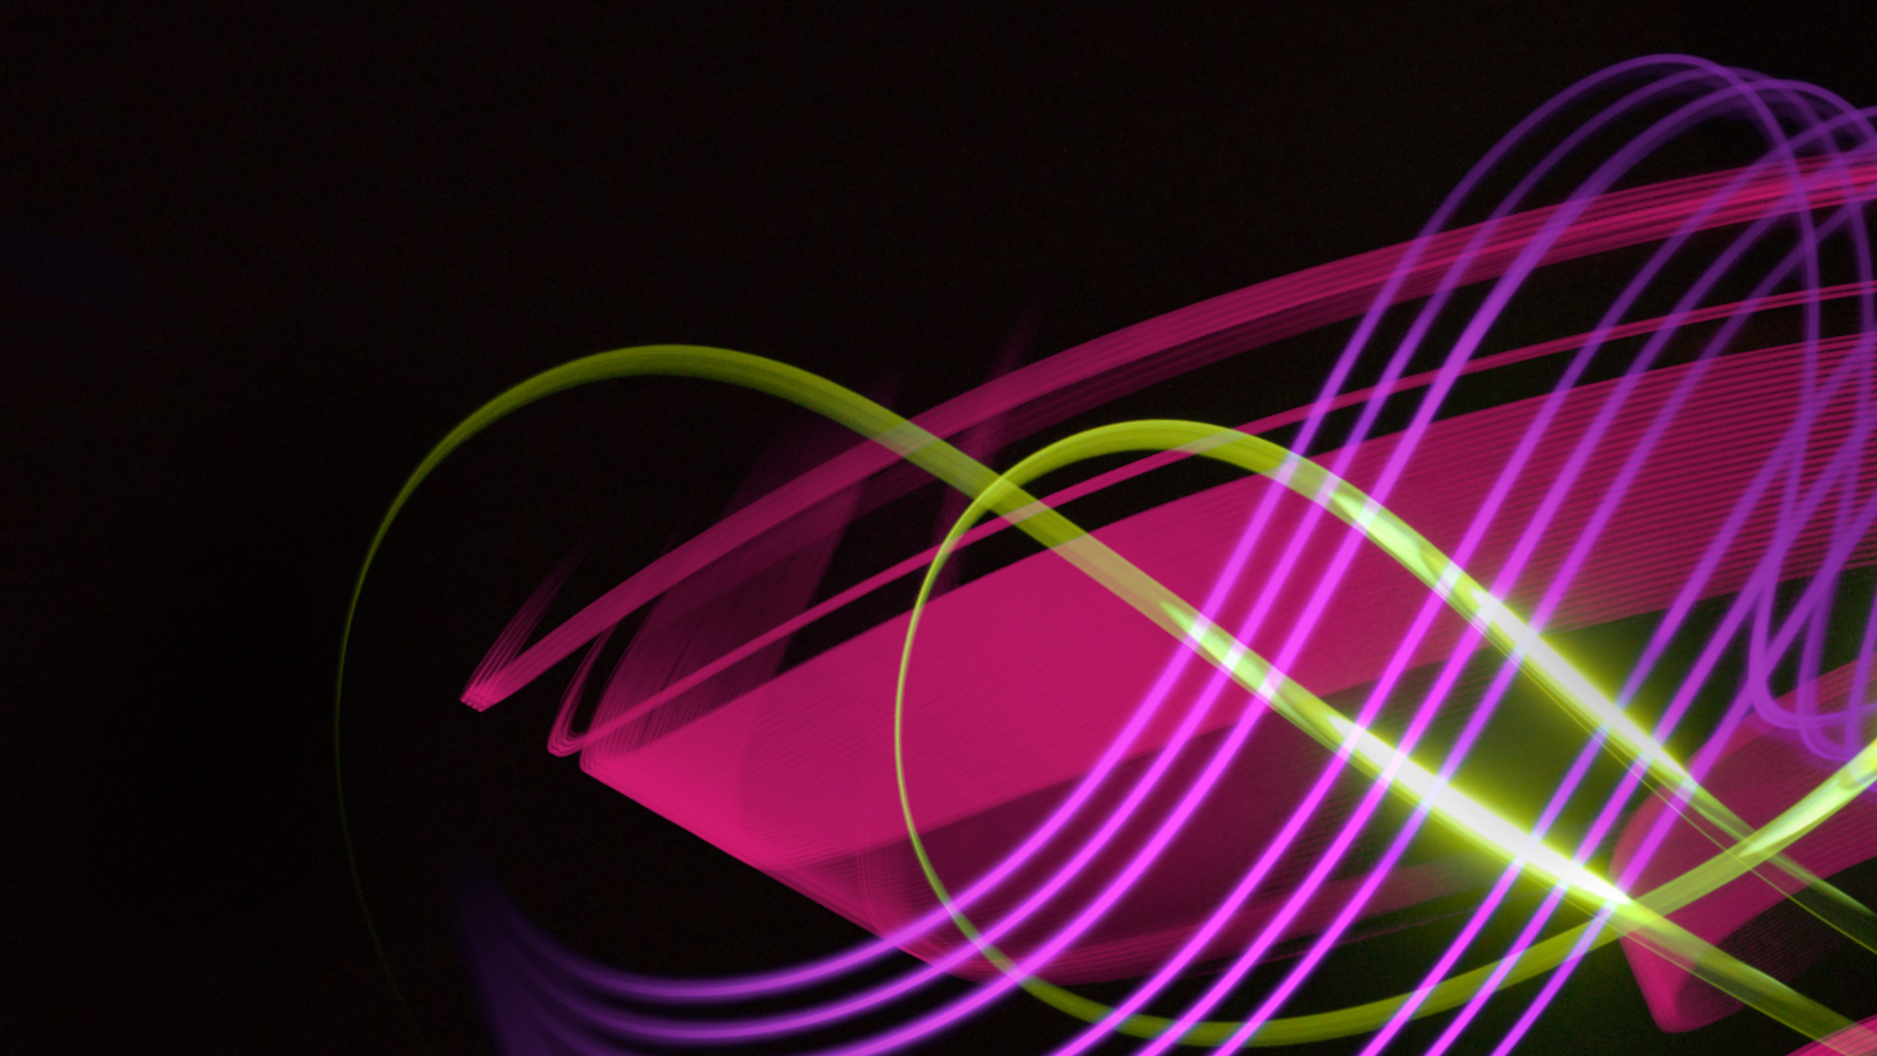
Out of Home works for Health & Beauty brands

Slide 2






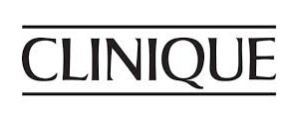







Leading Health & Beauty brands trust Out of Home
£5.4m
EE
£5.3m
£3.4m
£2.3m
£1.9m
£1.7m
£1.5m
£1.4m
£01.2m
£1.0m
£0.9m
£0.8m
£0.8m
£0.8m
£0.8m

Slide 3
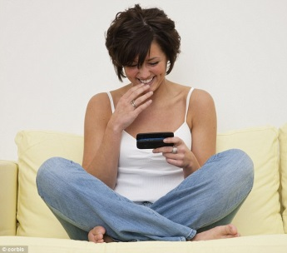
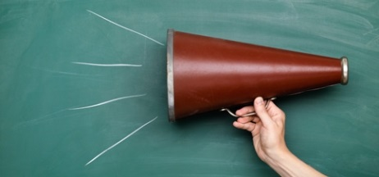
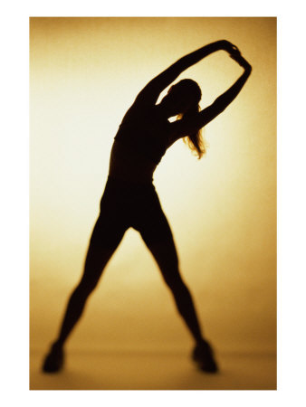

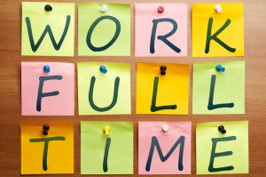
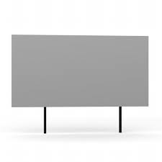
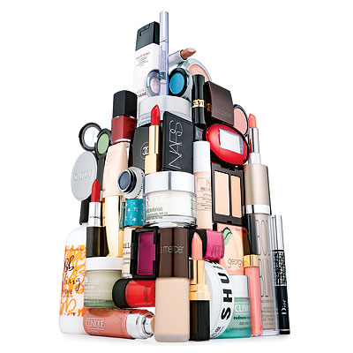
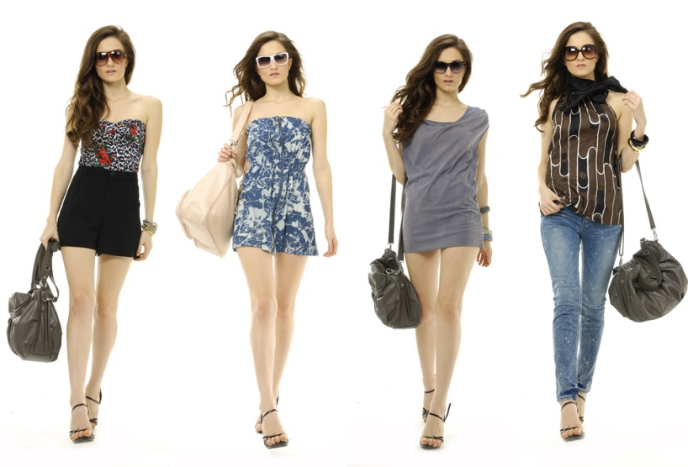
People who see a lot of posters use a lot of Health & Beauty products
Heavily opinionated about health & beauty products and happy to share their views with others, both off and online
Health conscious, sporty, active
Young, in full time
employment, upscale
and high income
HEAVY
OOH CONSUMPTION
“
The people you most reach with outdoor advertising are the people you most want to reach
Care greatly about their appearance and open to new ideas
Heavy users of health & beauty products –particularly body and face cleansing products, hair products, perfumes and deodorants

Slide 4
More mobile = more spontaneous
What sort of products are you likely to buy spontaneously?
Source: Mobile Pound Research, Dipsticks Research
Base: 1100 London interviews
Notes:
Across a range of different consumer product fields (clothing, magazines, music, cosmetics and toiletries, entertainment) the answer came back the same. There is a spontaneity to the heavier outdoor group’s purchasing behaviour which is not found in the other two groups. The more time people spend out of home, the more they act on impulse, which again makes them an excellent target for trying new brands and responding to ads on the street.

Slide 5
People who see a lot of posters connect strongly with Health & Beauty
Those heavily exposed to Out of Home are also heavy purchasers, actively interested in and very likely to influence others about Health & Beauty products
%
Index
Source: Exterion Media, TGI Media Neutral quintiles 2014
“Heavy” quintile is the 20% of the media audience who consume that medium most, ie the most typical consumer of that medium
Index base All Adults

Slide 6
People who see posters for health & beauty products are more likely to act
Those seeing OOH ads are more likely to search and learn about companies or products they’ve seen advertised, but people in market for health & beauty products are even more likely to do so
The Customer Journey 2012
Searched from home/work

Slide 7
Higher exposure to OOH increases search and purchase for health & beauty products
Repeated exposure to OOH generates an uplift in web searching
and on purchase especially at the highest exposure (e.g. 5+ exposures)
The Customer Journey 2012

Slide 8
Women who see a lot of OOH are also heavy users of Perfume
Index
Source: Exterion Media, TGI Media Neutral quintiles 2014
“Heavy” quintile is the 20% of the media audience who consume that medium most, ie the most typical consumer of that medium
Index base All Women

Slide 9
Women who see a lot of OOH are also heavy users of Face Creams & Lotions
Index
Source: Exterion Media, TGI Media Neutral quintiles 2014
“Heavy” quintile is the 20% of the media audience who consume that medium most, ie the most typical consumer of that medium
Index base All Women

Slide 10
Women who see a lot of OOH are also heavy users of Body Creams & Lotions
Index
Source: Exterion Media, TGI Media Neutral quintiles 2014
“Heavy” quintile is the 20% of the media audience who consume that medium most, ie the most typical consumer of that medium
Index base All Women

Slide 11
Women who see a lot of OOH are also heavy users of Deodorants
Index
Source: Exterion Media, TGI Media Neutral quintiles 2014
“Heavy” quintile is the 20% of the media audience who consume that medium most, ie the most typical consumer of that medium
Index base All Women

Slide 12
Out of Home is the medium experienced most recently before shopping
Recency is a big driver of ad recall and influence
Outdoor is overwhelmingly the medium shoppers recall seeing or hearing most recently
Source: ‘Last Window of Influence’ study, recalled advertising in last 30 minutes

Slide 13
If production costs are included, Outdoor is the most efficient medium for FMCG brands
Revenue return on investment, all media, FMCG
Sample Set: All FMCG Results Vault studies with measured Outdoor RROI

