Slide 1
Out of Home works for Entertainment & Media brands

Slide 2
Out of Home is a key medium for Entertainment & Media brands

Slide 3
Leading Entertainment & Media brands trust Out of Home
£12.6m
EE
£9.6m
£8.9m
£8.4m
£7.9m
£6.8m
£6.5m
£5.0m
£4.4m
£3.8m
£3.8m
£3.2m
£3.0m
£2.9m
£2.6m

Slide 4
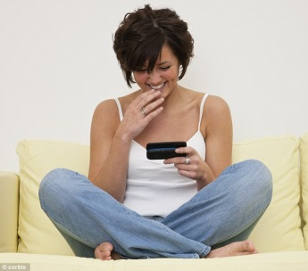
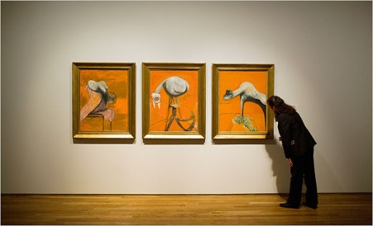
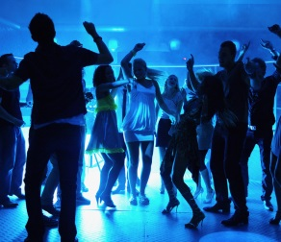
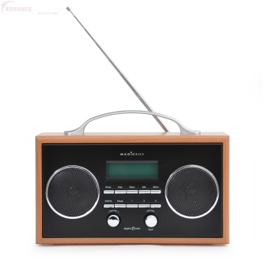
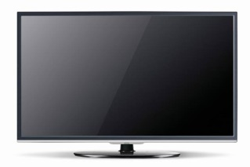
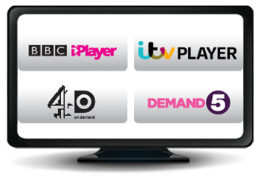
People who see a lot of posters are heavy tech and media users
Heavily opinionated about media and entertainment products and happy to share their views with others, both off and online
Cultured, and social
Young, in full time
employment, and
upscale
HEAVY
OOH CONSUMPTION
Confident and Progressive users of technology
Heavy users of other Media - Cinema, Radio, TV and online too, TV On Demand, YouTube and social networks.

Slide 5
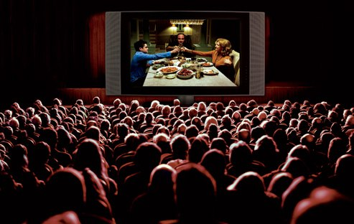
Some groups of OOH viewers can be even more defined
15-24yrs heavy OOH
Light TV heavy OOH
Freq Cinema heavy OOH
More likely to own digital tech at home such as wireless digital streamers and media centres. Particularly heavy users of TV On Demand. More interested in tech than the arts and even more opinionated about TV than most heavy OOH consumers
More likely to watch TV On Demand, particularly Sky product, and 3D films at the cinema. Highly cultured with even more opinionated and likely to share views on TV than most heavy OOH consumers
Most likely to download films/TV programmes at home as well as music. More likely to share opinions about arts/culture and heavy users of BT Vision
Notes:
And considerable incremental awareness to other media too ....
Note to sales team: there is bound to a be a bias here as case studies submitted to OMC will by nature only be success stories! So we’re probably talking significant spend and good creative – but it does show that when you get outdoor right that it can make a substantial difference.

Slide 6
Some groups of OOH viewers can be even more defined
Index
TV
Press
Radio
Internet
Source: Exterion Media, TGI Media Neutral quintiles 2014
“Heavy” quintile is the 20% of the media audience who consume that medium most, ie the most typical consumer of that medium
Index Base Heavy Consumption OOH
Source: OMC, Recognition/Attribution from database of case studies
Notes:
And considerable incremental awareness to other media too ....
Note to sales team: there is bound to a be a bias here as case studies submitted to OMC will by nature only be success stories! So we’re probably talking significant spend and good creative – but it does show that when you get outdoor right that it can make a substantial difference.

Slide 7
A truly broadcast audience for Entertainment and Media brands
82% of UK adults have seen OOH in the past week and a highly visible medium to heavy users of other offline and online media
%
Source: Exterion Media, TGI Media Neutral quintiles 2014
“Heavy” quintile is the 20% of the media audience who consume that medium most, ie the most typical consumer of that medium

Slide 8
People who see film posters are more likely to act
Those seeing OOH ads are more likely to search and learn about companies or products they’ve seen advertised, but people in the cinema market are even more likely to do so
The Customer Journey 2012
Searched from home/work

Slide 9
For cinema releases, frequency builds search and purchase
Repeated exposure to OOH generates an uplift in web searching and on purchase especially at the highest exposure (e.g. 5+ exposures)
The Customer Journey 2012

Slide 10
The Out of Home audience influential in persuading others about TV
Index
Source: Exterion Media, TGI Media Neutral quintiles 2014
“Heavy” quintile is the 20% of the media audience who consume that medium most, ie the most typical consumer of that medium
Index base All Adults talked about/convinced about TV

Slide 11
Out of Home audiences offer the keenest approach to music downloads
Volume spend on Music Downloads in past 12 mths
Source: Exterion Media, TGI Media Neutral quintiles 2014
“Heavy” quintile is the 20% of the media audience who consume that medium most, ie the most typical consumer of that medium

Slide 12
The Out of Home audience actively watches TV On Demand
000
Watched TV On Demand in past 12 mths
Source: Exterion Media, TGI Media Neutral quintiles 2014
“Heavy” quintile is the 20% of the media audience who consume that medium most, ie the most typical consumer of that medium

Slide 13
Entertainment campaigns get noticed
“Which of the following have you seen advertised recently using outdoor advertising – New films, TV programmes, theatrical shows, books and music?”
Source: YouGov survey of 1,692 respondents, May 2011

