Slide 1
Out of Home works for Motor brands

Slide 2
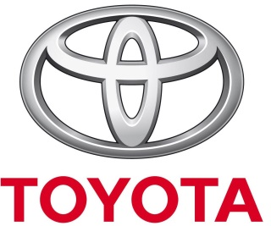
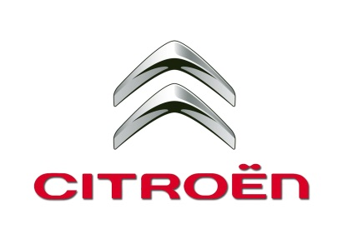
Leading Motors brands use Out of Home to drive awareness
£6.2m
EE
£4.7m
£3.2m
£2.5m
£2.25m
£2.23m
£2.1m
£1.8m
£1.65m
£1.65m

Slide 3
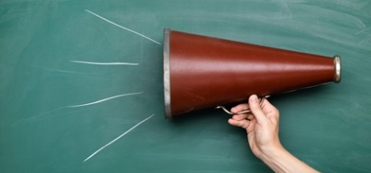
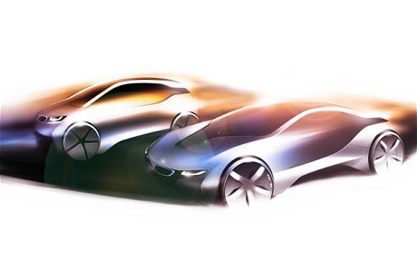
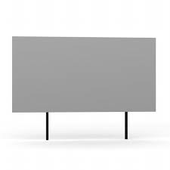
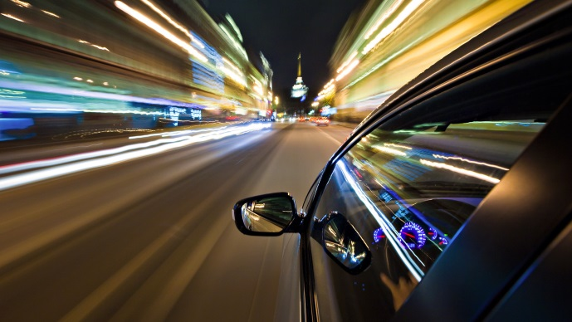
People who have high exposure to Out of Home are active drivers
Actively interested in cars and happy to share their views with others, both off and online
HEAVY
OOH CONSUMPTION
In full time employment,
upscale, high income,
active and highly mobile
Covers a broad range of model ownership from sports cars and convertibles to off roaders and estate cars. Most likely of all media consumers to have bought a car in the past year, to drive more miles, spend most on their cars and enjoy driving
Cars are an important status symbol for this audience . Brand image is important, as is a car’s personality and looks

Slide 4
Out of Home is the most relevant media choice for Automotive brands
Index
Source: Exterion Media, TGI Media Neutral quintiles 2014
“Heavy” quintile is the 20% of the media audience who consume that medium most, ie the most typical consumer of that medium
Index base Car Owners (Agree with statement)

Slide 5
Cars are an important status symbol for the Out of Home audience
Index
Source: Exterion Media, TGI Media Neutral quintiles 2014
“Heavy” quintile is the 20% of the media audience who consume that medium most, ie the most typical consumer of that medium
Index base Car Owners (Agree with statement)

Slide 6
People who see automotive posters are more likely to act
Those seeing OOH ads are more likely to search and learn about companies or products they’ve seen advertised, but people in the car market are even more likely to do so
The Customer Journey 2012

Slide 7
Out of Home is the most relevant media choice for car brands
Index
Source: Exterion Media, TGI Media Neutral quintiles 2014
“Heavy” quintile is the 20% of the media audience who consume that medium most, ie the most typical consumer of that medium
Index base All Adults

Slide 8
People who see a lot of posters are highly connected with car brands
Those heavily exposed to Out of Home are also actively interested in, and very likely to influence others about cars and associated services
Index
Source: Exterion Media, TGI Media Neutral quintiles 2014
“Heavy” quintile is the 20% of the media audience who consume that medium most, ie the most typical consumer of that medium
Index base Car Owners

