Slide 1
Out of Home works for Retail brands

Slide 2
Leading Retail brands trust Out of Home
£3.8m
EE
£1.9m
£1.8m
£1.8m
£1.7m
£1.4m
£1.4m
£1.0m
£0.7m
£0.7m
£0.7m
£0.6m
£0.6m
£0.6m
£0.5m

Slide 3
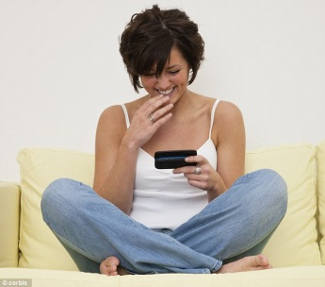
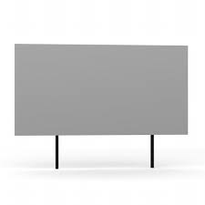
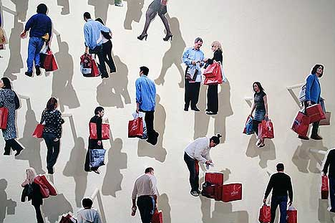
People who see a lot of Out of Home are also dedicated shoppers
Actively interested in retail and happy to share their views with others, both off and online (particularly ‘male shoppers’)
Young, in full time
employment, upscale,
high income, active
and highly mobile
HEAVY
OOH CONSUMPTION
Ad aware, tend to enjoy the shopping experience in store and online too, see online retail as a way to make life easier.
Dedicated and frequent shoppers. Out and about, in an active mindset for product messaging, high propensity for impulse purchase.

Slide 4
Out of Home audience is highly relevant for retailers and retail centres
Index
Source: Exterion Media, TGI Media Neutral quintiles 2014
“Heavy” quintile is the 20% of the media audience who consume that medium most, ie the most typical consumer of that medium
Index base All Adults

Slide 5
Outdoor is the medium experienced most recently before shopping
Recency is a big driver of ad recall and influence
Outdoor is overwhelmingly the medium shoppers recall seeing or hearing most recently
Source: ‘Last Window of Influence’ study, recalled advertising in last 30 minutes

Slide 6
Receptive audience: most people on the street are buying something
Q: Have you bought or do you expect to buy anything during this trip out today?
85% bought or expect to buy something
Source: London Shopper Survey, Clark Chapman Research (324 random London street intercept interviews)
Notes:
“You don’t leave home without your wallet”. That means consumers out of home are always in a position to make a purchase. What is more, the people you see on the street are not just a random cross-section of people. They are more valuable than that: they are people on a mission to spend. This is substantiated by 2006 Clark Chapman findings which show that 85% of people on the street at any time have bought something or intend to buy something on that specific trip out of home.

