Slide 2
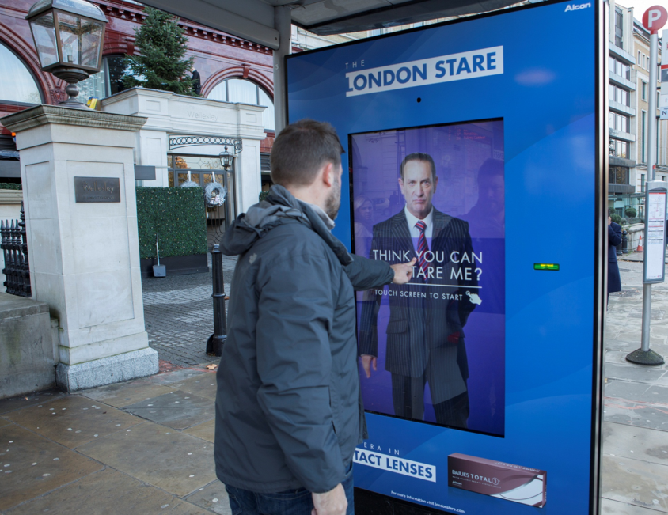
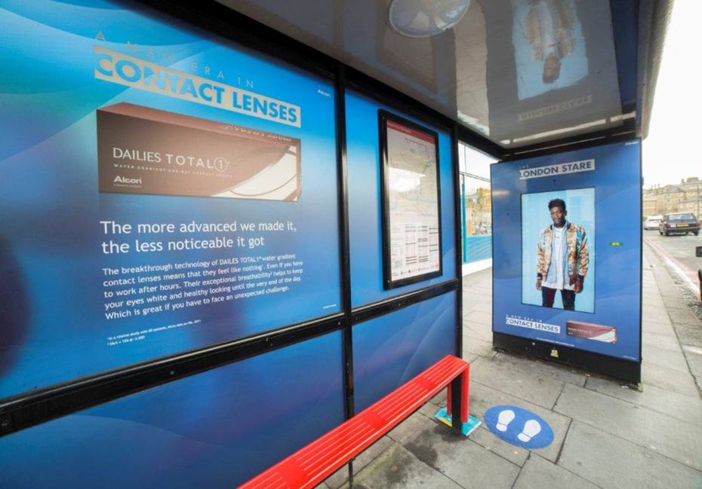
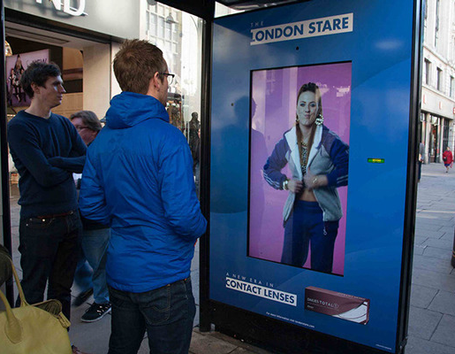
Case study: Alcon
In the past, Alcon, the world’s leading eye care company, had only undertaken B2B advertising. With a change in strategy, they wanted to launch themselves into the consumer environment with a campaign which would generate substantial PR opportunities as well as provide redeemable vouchers to encourage consideration of their products.
The campaign utilised digital bus shelters to bring to life the very first blink tracking digital application. The consumer was asked to have a ‘stare off’ with a variety of stereotypical London characters. Who ever blinks first loses however, regardless of whether they won or lost, they were given the opportunity to print a voucher which entitled them to a free test of the contact lenses, available at local stockists.
The interactive campaign achieved stand-out results. The ‘stare off’ was played a total of 16,372 times over the length of the campaign and 3,111 vouchers were printed for redemption. In addition, a total of 228,759 people were recorded to have looked at the ad.

Slide 3
Outsmart
Third Floor
43 Dorset Street
London W1U 7NA
outsmart.org.uk

