Slide 2
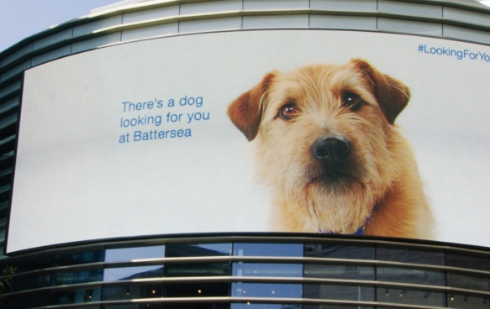
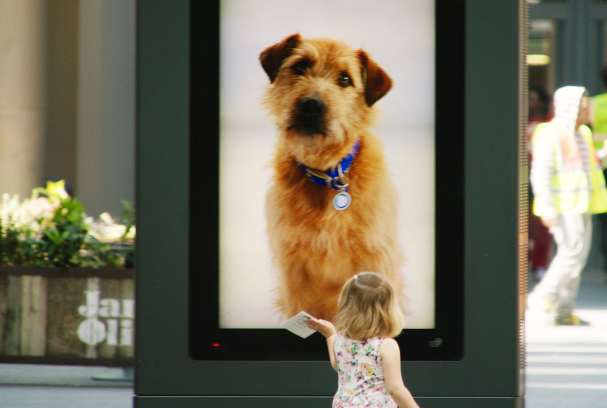
Case study: Battersea Dogs Home
Battersea Dogs Home wanted to increase the number of public enquires into adopting the stray dogs which are cared for by the charity. To do so, Battersea Dogs Home needed to engage with the public and remind them why dogs are man’s best friend.
The charity’s #LookingForYou campaign used Digital Out of Home to dominate screens across Westfield Stratford. People visiting the shopping centre were handed specially designed leaflets containing an RFID tag. The tag within the leaflet triggered a video of Barley, a former Battersea dog, to play and interact with the public.
The playful yet moving campaign was a huge success with a 33% increase in traffic to the charity’s website. The campaign also achieved 10 times more enquires into adopting dogs than the charity had previously experienced. Finally, #LookingForYou showcased the innovative use of DOOH and won 2 Bronze Lion Awards at Cannes Lions International Festival of Creativity.

Slide 3
Outsmart
Third Floor
43 Dorset Street
London W1U 7NA
outsmart.org.uk

