Slide 2
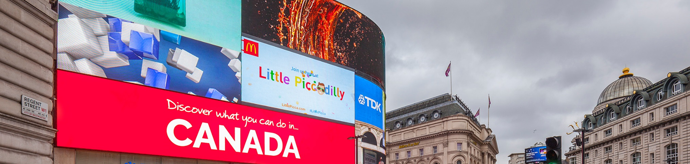
Case study: Canadian Affair
Canadian Affair wanted to promote themselves as a specialist in tailor-made holidays as well as launch their 20th anniversary sale. The objectives were to raise awareness of the brand in the UK marketplace, particularly in the regions where flights depart from.
As an integral element of the campaign, digital Out of Home was used to encourage the audience to visit Canadian Affair’s website. Using a combination of iconic screens including Piccadilly One and others at specific Rail and Underground stations, Canadian Affair ensured that their brand was visible to commuters on key days of the week.
The results were outstanding with a 64% increase in calls YoY during the campaign period. The OOH activity also initiated an increase in visits from UK consumers to the website on the days the LCD and XTP sites on the Underground were live. Online activity increased on every day the digital OOH campaign was live, generating uplifts ranging from 22% to 40%. On average the digital OOH activity increased online traffic to the Canadian Affair website by 28%.

Slide 3
Outsmart
Third Floor
43 Dorset Street
London W1U 7NA
outsmart.org.uk

