Slide 2
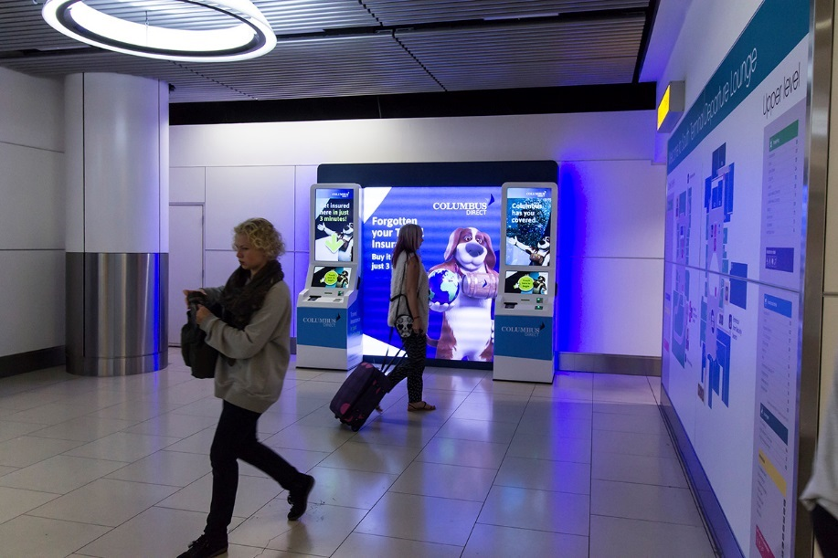
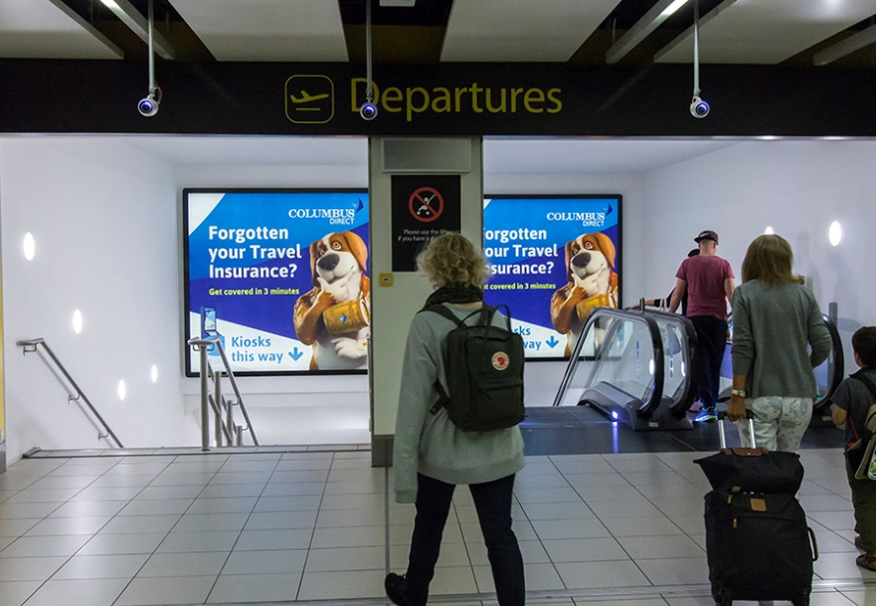
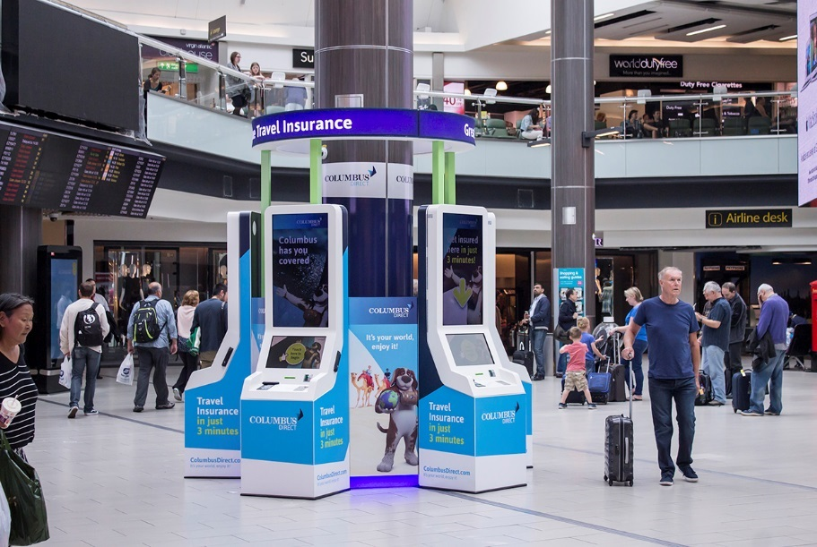
Case study: Columbus Direct
Columbus Direct wanted to provide passengers with the opportunity to buy travel insurance just before departure. In order to represent the strong customer service which Columbus pride themselves on, it was important that the opportunity was convenient, easy-to-use and customer friendly.
Columbus Direct placed specially-built interactive kiosks in Gatwick’s South Terminal lounge area, to maximise engagement. The kiosks sold Columbus Direct’s products to departing passengers who had forgotten to purchase travel insurance before heading abroad. Using Gatwick Airport’s innovative formats, the campaign utilised both digital and experiential Out of Home to create noise around their competitive rates.
The results were exceptional with a significant sales uplift of 57% being achieved during the Digital OOH campaign. The highest take-up was from Millennial passengers (aged 25-34), closely followed by 18-25 year olds.

Slide 3
Outsmart
Third Floor
43 Dorset Street
London W1U 7NA
outsmart.org.uk

