Slide 2
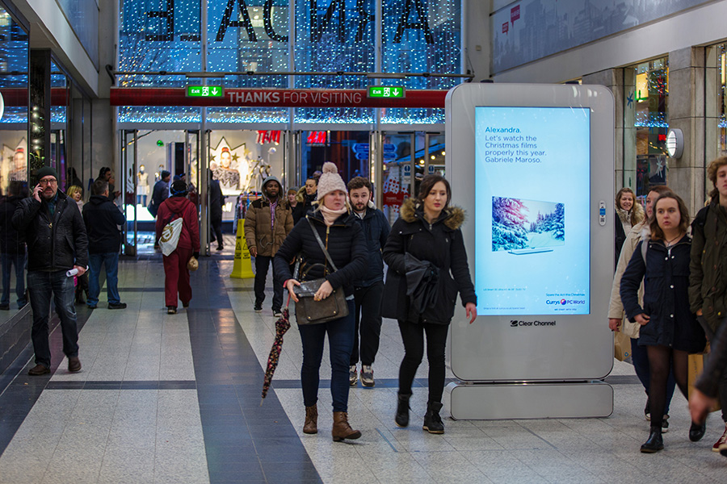
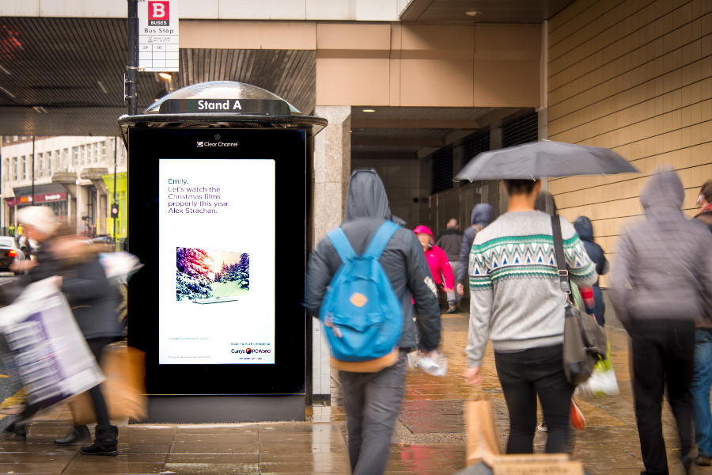
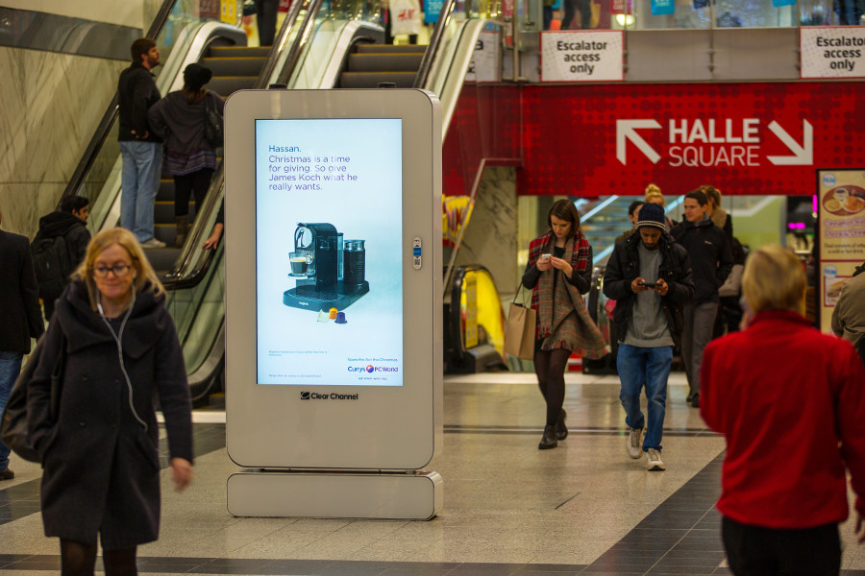
Case study: Curry’s PC World
In a competitive festive market Curry’s PC World wanted to make their brand top of the consumers Christmas list. The Spare the Act campaign humorously reassured the public that they could avoid gift disappointment by shopping at Curry’s PC World.
The personalised digital Out of Home campaign encouraged people to drop their friends and family some not-so-subtle hints about what they really wanted for Christmas using a bespoke website. These requests were then served in 1,000’s of locations that people could select as the most relevant to their loved ones. The national campaign ran across digital 6 sheets and large digital formats.
The results were staggering as Curry’s achieved its objective of being front of mind during the Christmas period with a 31% increase in advertising cut through among those exposed to DOOH. Also those that had seen the digital creative were twice as likely to agree with positive statements relating to the OOH creative. Lastly, 30% of respondents agreed that they were more likely to consider purchasing gifts at Curry’s after seeing the ad.

Slide 3
Outsmart
Third Floor
43 Dorset Street
London W1U 7NA
outsmart.org.uk

