Slide 1
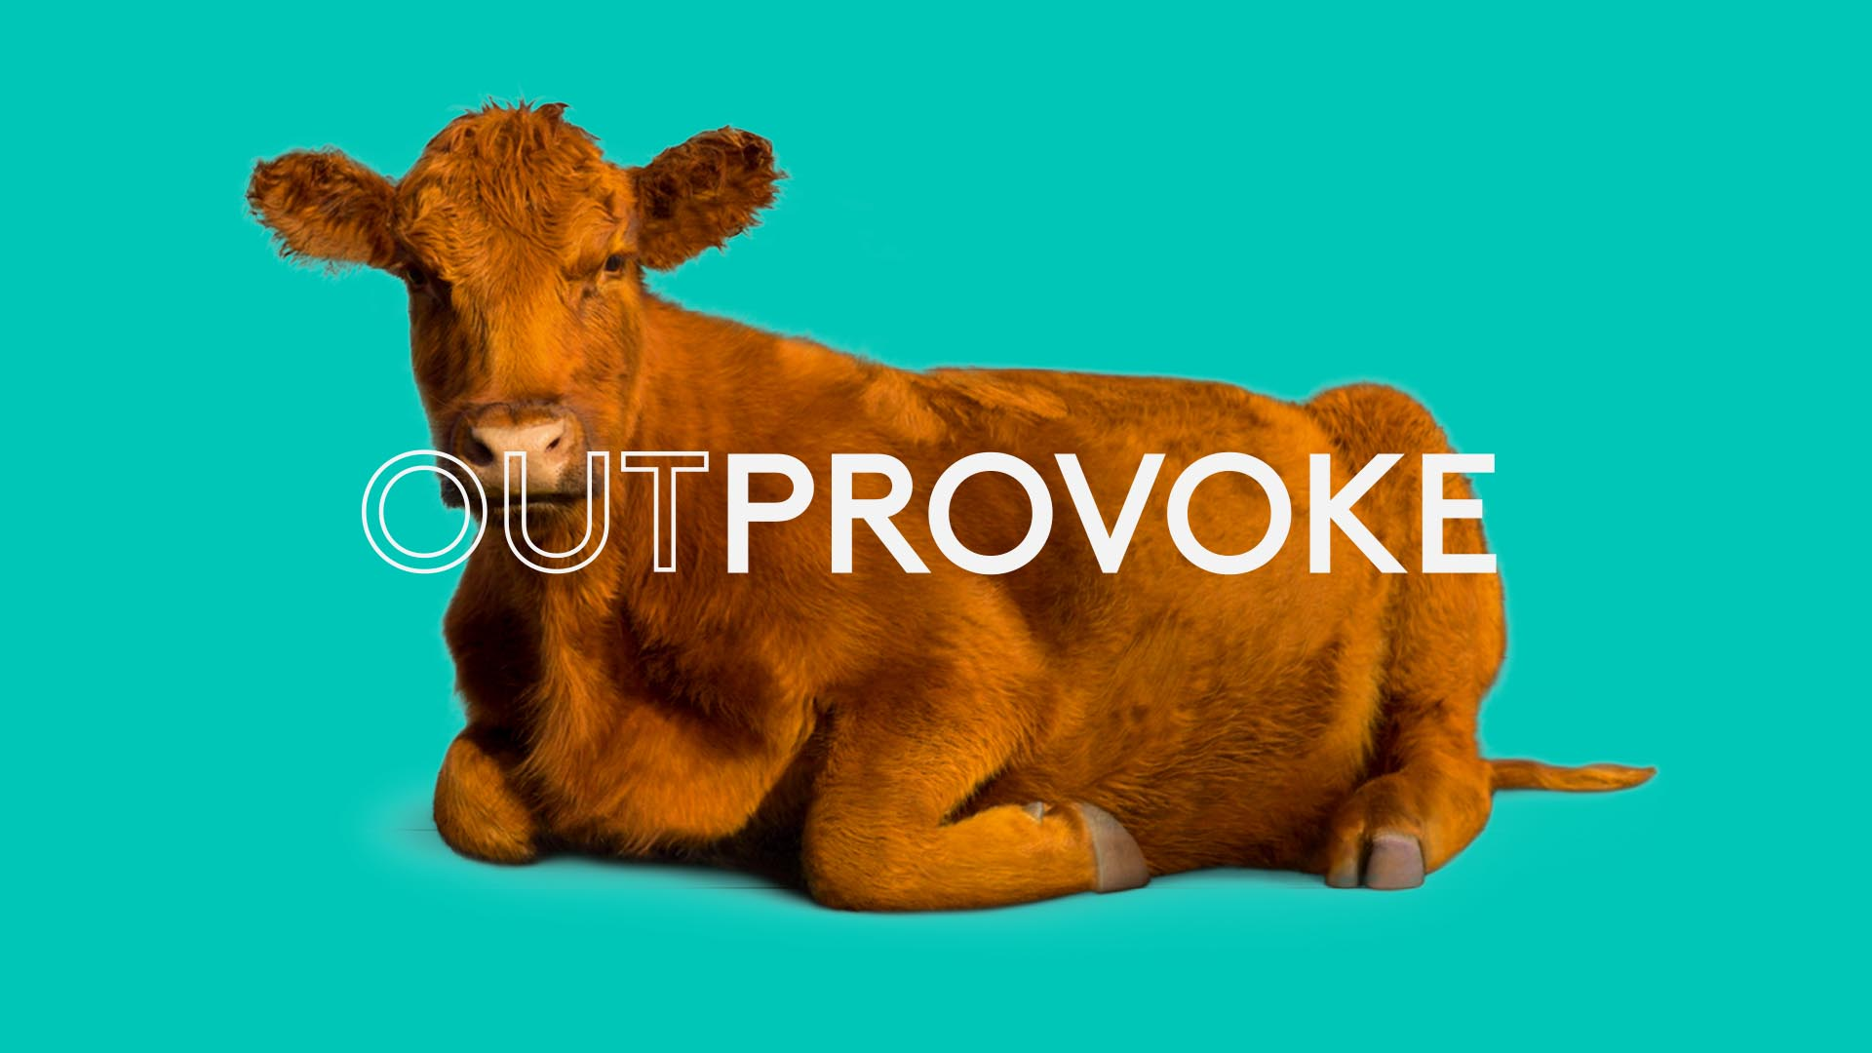

Slide 2
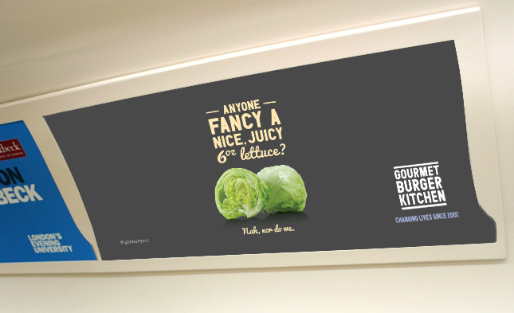
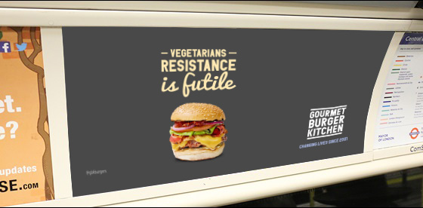
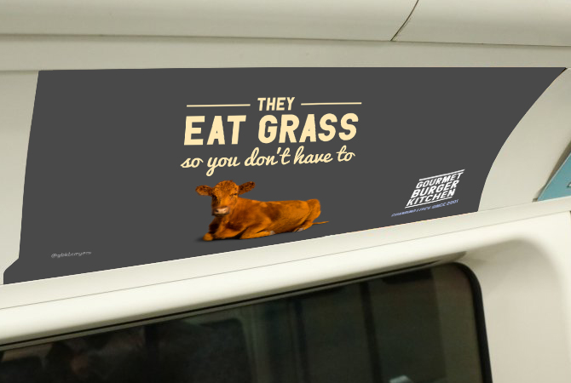
Case study: Gourmet Burger Kitchen
In an increasingly competitive premium burger market, Gourmet Burger Kitchen set out to regain the attention of their beloved consumers. To achieve this, GBK created a memorable campaign that conveyed their unwavering belief in the quality of their burgers.
In order to raise awareness, an Out of Home campaign was created, based on the fact that GBK only uses the highest quality ingredients in their kitchens. The campaign didn’t set out to rile or offend the vegetarian and vegan community, but rather reinforce the quality of their food. The campaign ran across the London Underground on cross track 16 sheets, digital 6 sheets, digital escalator panels, tube car panels and large digital formats.
The campaign achieved unsolicited press coverage across the globe. GBK enjoyed 74% positive sentiment towards their brand online, an estimated 28.4 million impressions on Social Media and a total earned reach of over 1 billion. Post campaign analysis showed a meaty 14% growth in Like for Like sales during the campaign period, an increase of 8% Year on Year at the time.

Slide 3
Outsmart
Third Floor
43 Dorset Street
London W1U 7NA
outsmart.org.uk

