Slide 2
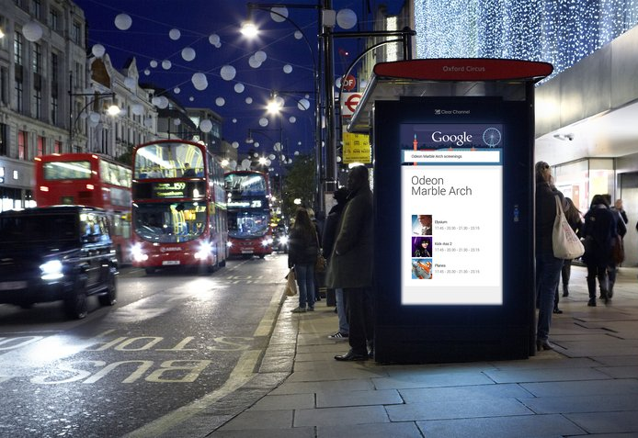
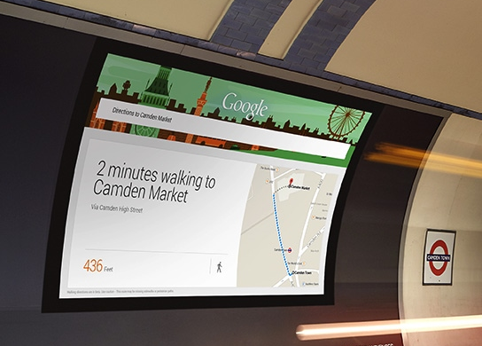
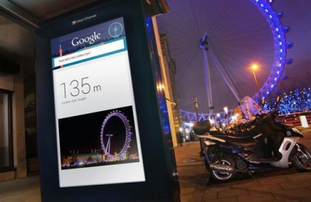
Case study: GOOGLE
Google Search is already part of most people’s everyday lives. The problem is, ‘Googling’ has become so natural that people rarely spare a thought for just how magical it is. Google’s challenge was to remind people of the magic of Google Search.
Harnessing the power of digital Out of Home, ‘Google Outside’ involved bringing the best of Google Search to the city of London. Powered by Google Search, digital Out of Home screens were used which anticipated the needs of passers by and served useful information which would add value to their day. 160 screens were used across London, including 100 Bus Shelter LCDs and 60 Cross-Track Projectors on the Underground.
The results achieved by the campaign were considerable. 92% of people found the content interesting; 89% found it informative; 78% learned something new; 68% found it personally relevant. The perception of Google as an innovative company increased 11 points to 81%.

Slide 3
Outsmart
Third Floor
43 Dorset Street
London W1U 7NA
outsmart.org.uk

