Slide 2
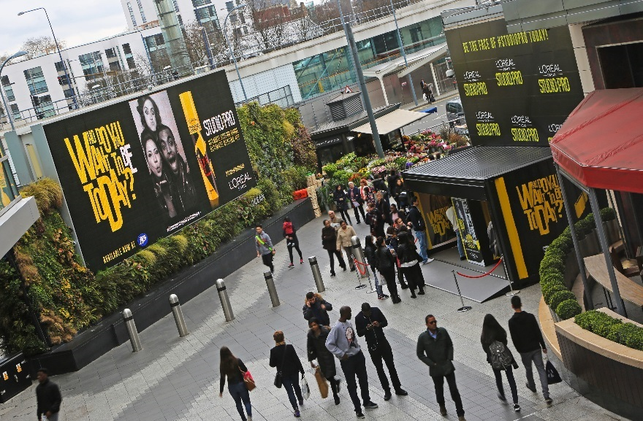
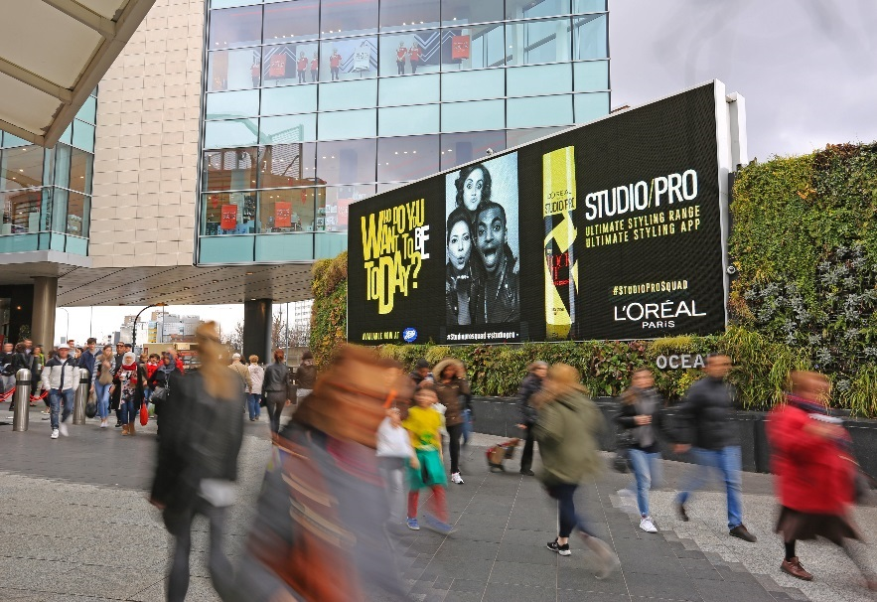
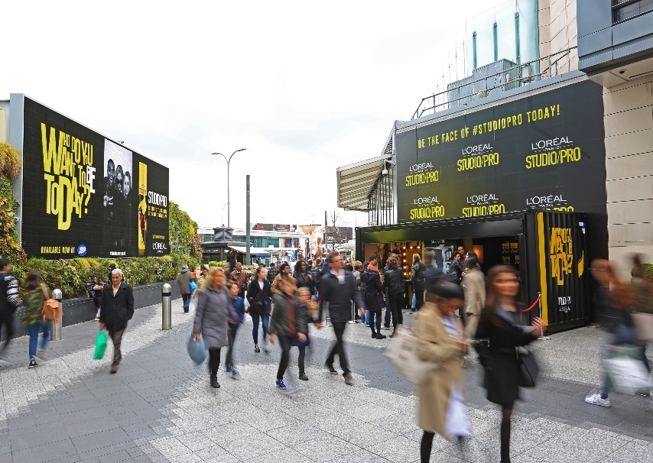
Case study: L’Oréal Paris
L’Oréal Paris wanted to create a standout campaign for the launch of the latest product in their infamous hair styling range: Studio Pro. An experiential Out of Home was chosen to create excitement and generate interest about the styling product.
The exclusive digital Out of Home campaign at Westfield London encouraged millennials to get a complimentary make-over, using only the Studio Pro styling products. They were then invited to snap their new looks in a photo booth and share them on social media. Their image was broadcast on Ocean Outdoor’s Eat Street screen, making them famous as the face of Studio Pro.
The campaign was a huge success. In the week that the campaign ran, the Boots store at Westfield London experienced the highest weekly sales of Studio Pro. This was 325% higher than any other week and made the store the best performing store to ever sell the product. The campaign gained 1.6 million organic social impressions and over 300,000 consumers saw the Out of Home screen at Westfield London. Around 1,000 consumers received a make-over at the styling station.

Slide 3
Outsmart
Third Floor
43 Dorset Street
London W1U 7NA
outsmart.org.uk

