Slide 2
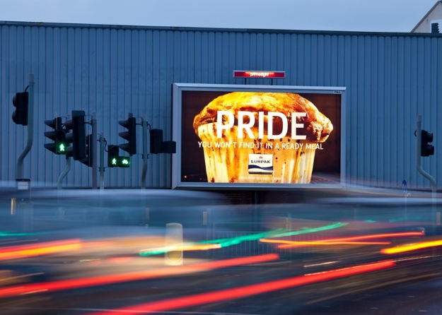
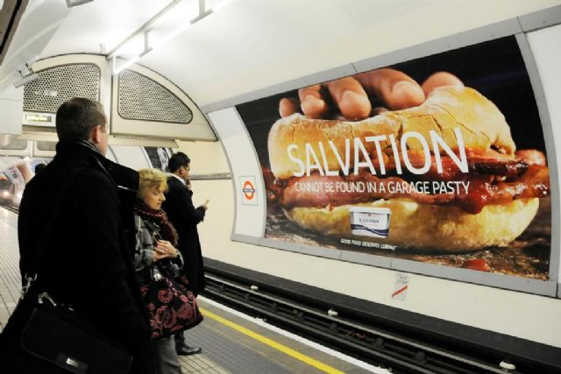
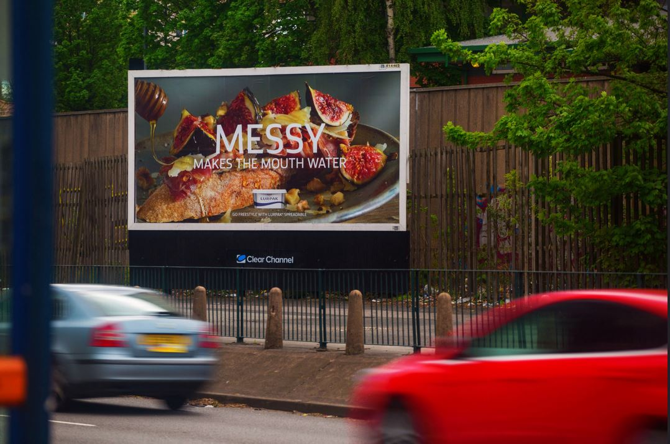
Case study: Lurpak
During a tough economy, Lurpak was hoping to create a positive impact and drive sales by encouraging people to indulge in traditional comfort foods.
The “Good, Proper Food” campaign used a bespoke mood-forecasting tool to judge the general mood of commuters throughout the week based on weather, search, and event data. Based on the results, different variations of the creative were released on digital screens across key locations of the commuter journey at peak travel times.
The real-time campaign worked wonders: getting noticed by more than 61% of the target audience. It also delivered above and beyond sales targets with a 9% year-on-year rise in sales.

Slide 3
Outsmart
Third Floor
43 Dorset Street
London W1U 7NA
outsmart.org.uk

