Slide 2
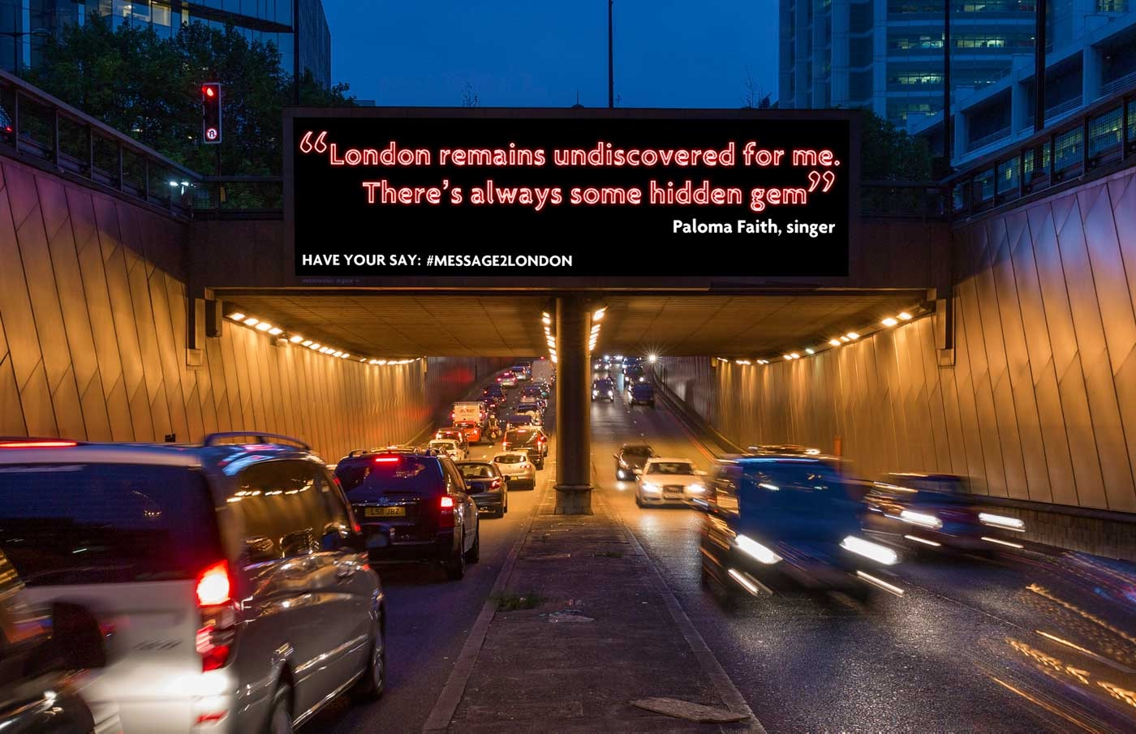
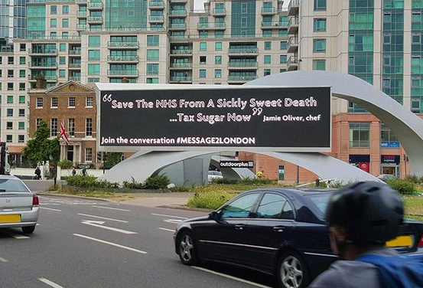
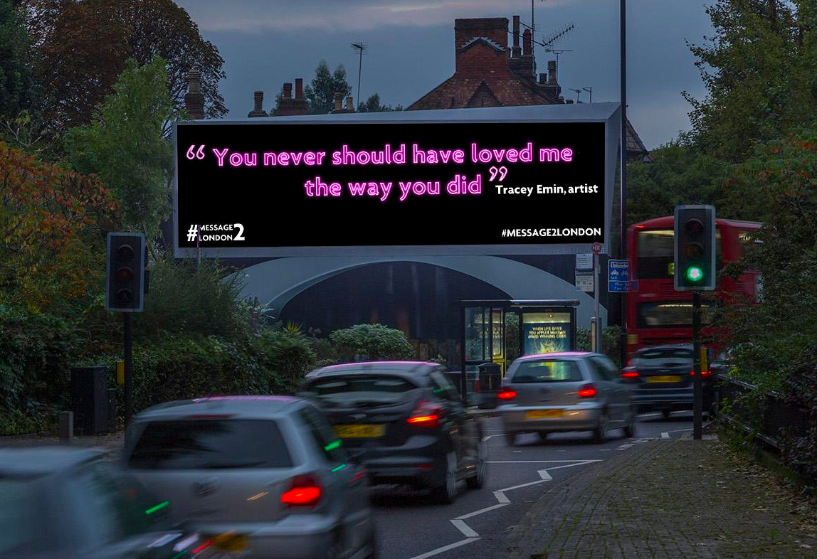
Case study: #message2london
Outdoor Plus wanted to demonstrate the power of Digital Out of Home. In particular, it was important to prove that premium and iconic digital formats deliver the most valuable audiences, who in turn recognise the value of the medium as a means of communication.
Celebrities including Idris Elba, Andy Murray, Bono and Tracey Emin were enlisted to send ten-word personal messages to London, which were broadcast across a network of 19 premium digital screens across the capital. These messages were used to encourage commuter’s engagement via a unique hashtag #message2london. The social media element, coupled with the use of premium sites, highlighted how Digital Out of Home can capture attention, create fame and enhance social media channels.
The #message2london campaigned achieved significant result, with prompted ad recall score of 42.2% and a pure spontaneous awareness score of 21.4%. The #message2London hashtag was used 1,800 times, leading to 19 million Twitter impressions. Insight from Dipsticks Research revealed that 28% of respondents had seen the hashtag #message2london on Digital Out of Home advertising. Furthermore, they considered the medium was effective at catching peoples attention and an innovative way to build trust for a brand.

Slide 3
Outsmart
Third Floor
43 Dorset Street
London W1U 7NA
outsmart.org.uk

