Slide 1
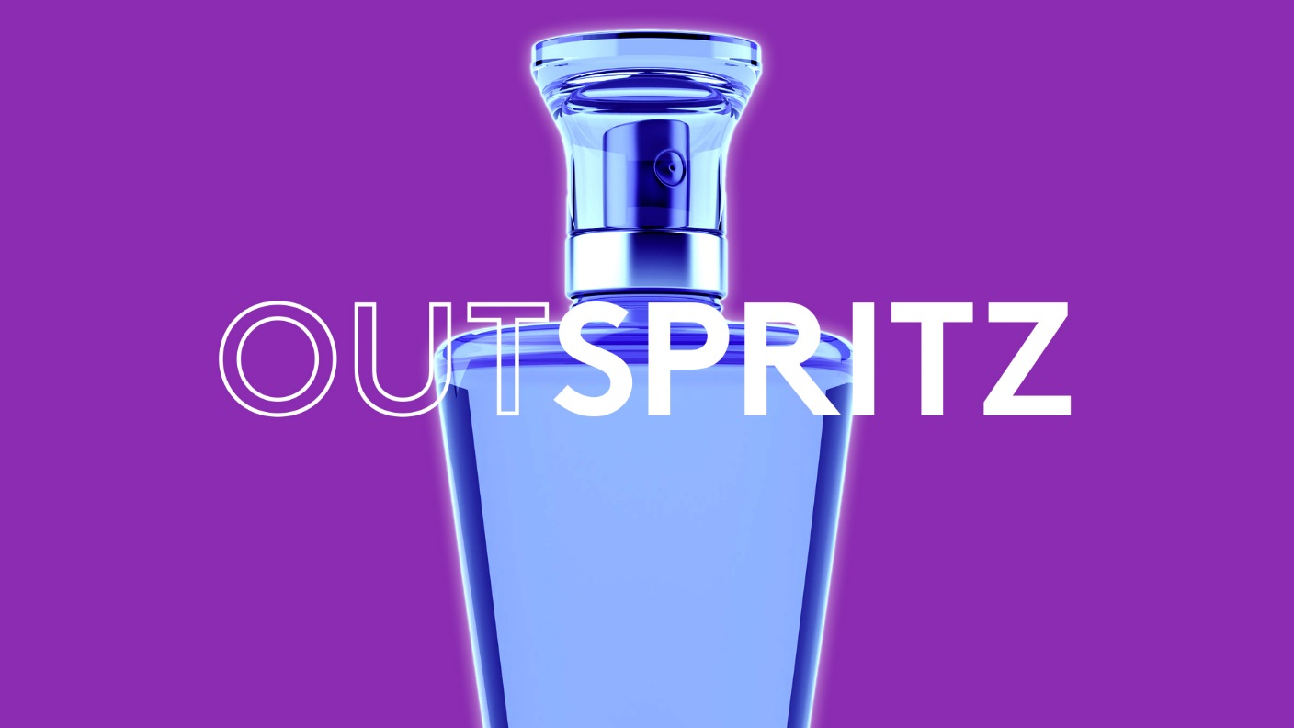

Slide 2
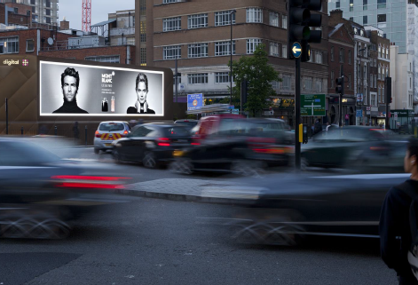
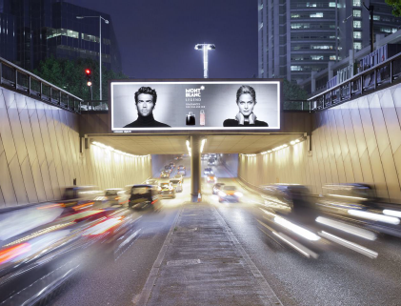
Case study: Mont Blanc
Mont Blanc were looking to promote their Legend brand of fragrance in the face of stiff competition. Out of Home, the solus medium, was chosen to provide the necessary standout and status for the Legend brand.
A mixture of high profile, ultra-premium digital screens and backlights were used to deliver standout and high impact across key London locations. In addition, iconic roadside digital sites and mall screens were used to underpin the brands premium status further.
High impact sites, superb locations and the real planning flexibility offered by digital Out of Home combined to deliver one of Mont Blanc Legend’s most successful campaigns to date.
The results were outstanding. In the first burst of OOH, market share was 35% higher in London zones which were supported by DOOH, as compared to the national share. Mont Blanc Legend achieved its highest ever market share during the month in which the burst of OOH activity took place. In addition, there was a significant increase in YoY sales, 2013 sales were 64% higher than the previous year. There was a 103% increase in sales from January – June 2013 versus January – June 2012.

Slide 3
Outsmart
Third Floor
43 Dorset Street
London W1U 7NA
outsmart.org.uk

