Slide 1
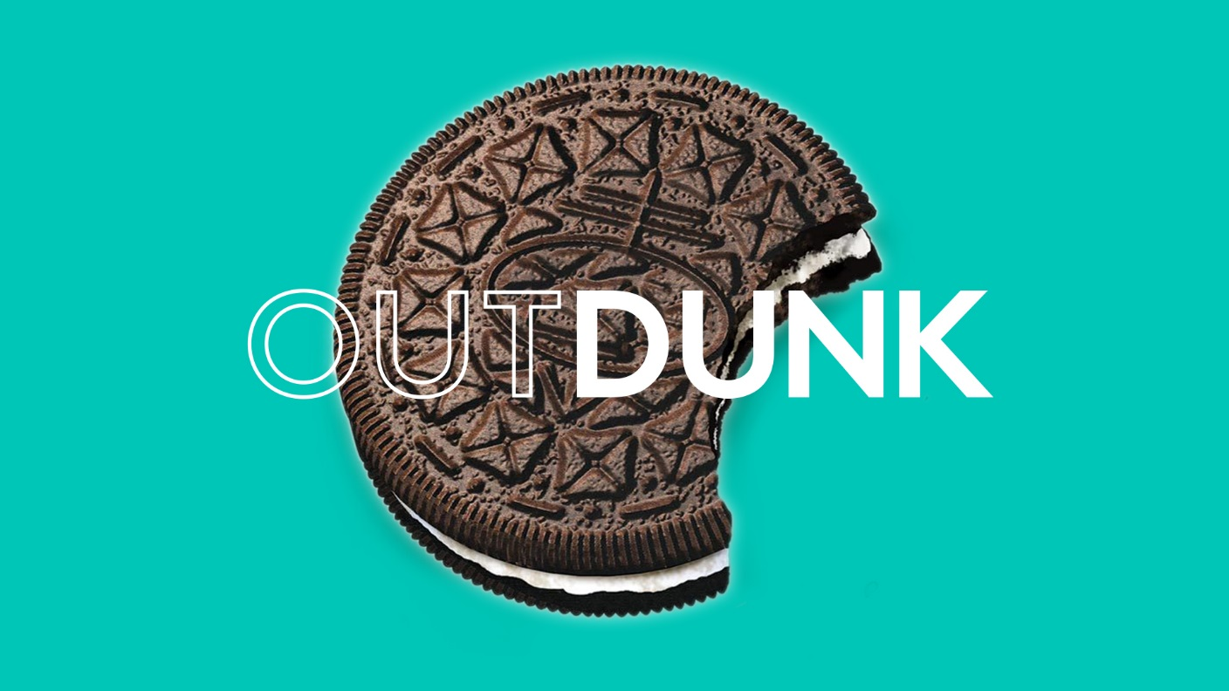

Slide 2
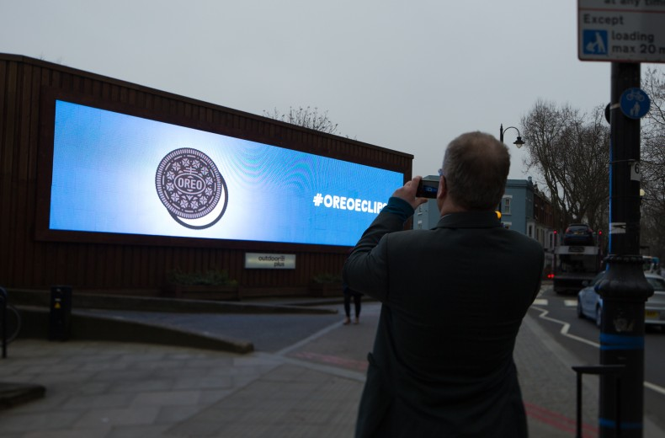
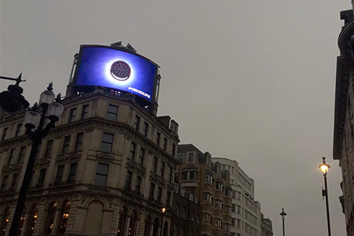
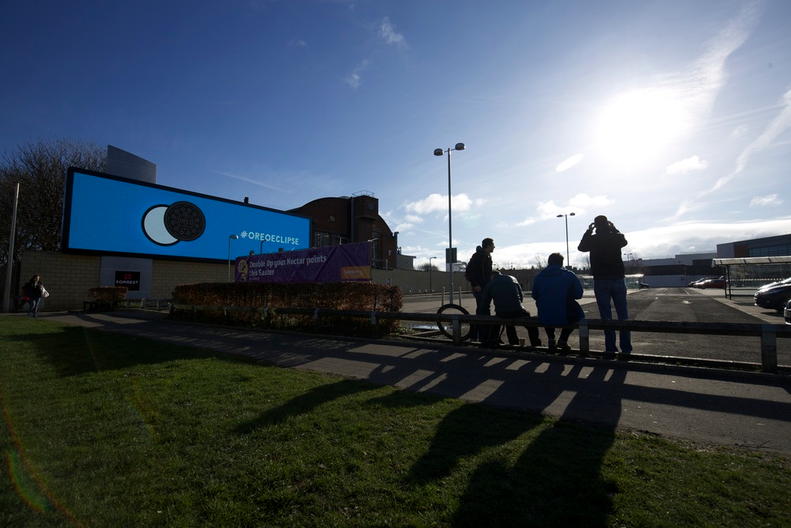
Case study: Oreo
As the UK collectively looked into the sky to witness the partial solar eclipse, Mondelēz International’s playfully created its own total eclipse across a number of different media outlets for one of its most well-known biscuit brands, Oreo.
The innovative and tactical digital Out of Home campaign, which went live in London and Edinburgh, used data from the Royal Astronomical Society and TimeAndDate.com to track the movement of the Sun in the sky. The eclipse was then replicated in real-time using an Oreo biscuit across a range of digital OOH formats.
#OreoEclipse received more than 6,000 tweets from approximately 40 different countries and the Oreo Eclipse video was seen by more than 20 million Brits. YoY sales following the Oreo Eclipse campaign rose by 59%, making the month of March 2015, Oreo’s highest ever UK sales month.

Slide 3
Outsmart
Third Floor
43 Dorset Street
London W1U 7NA
outsmart.org.uk

