Slide 2
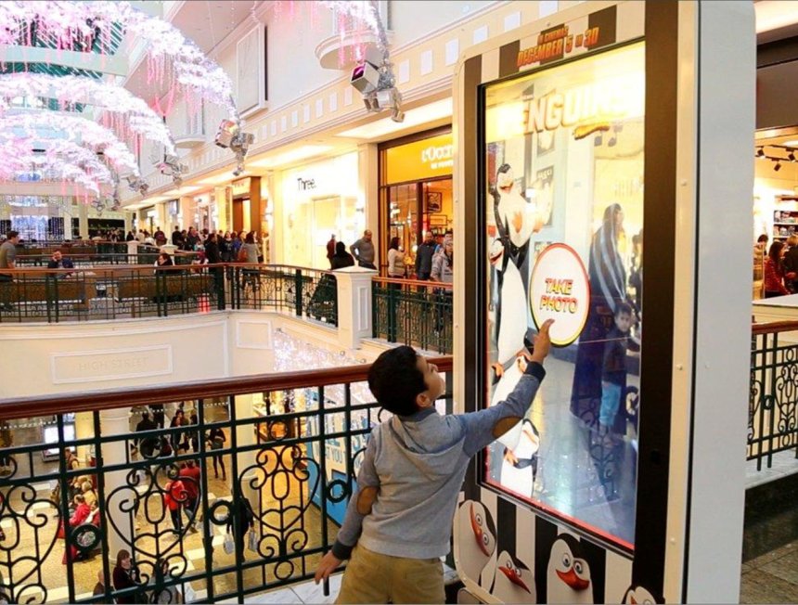
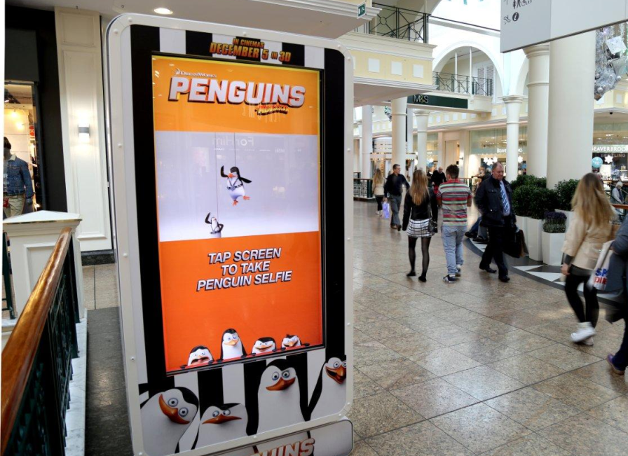
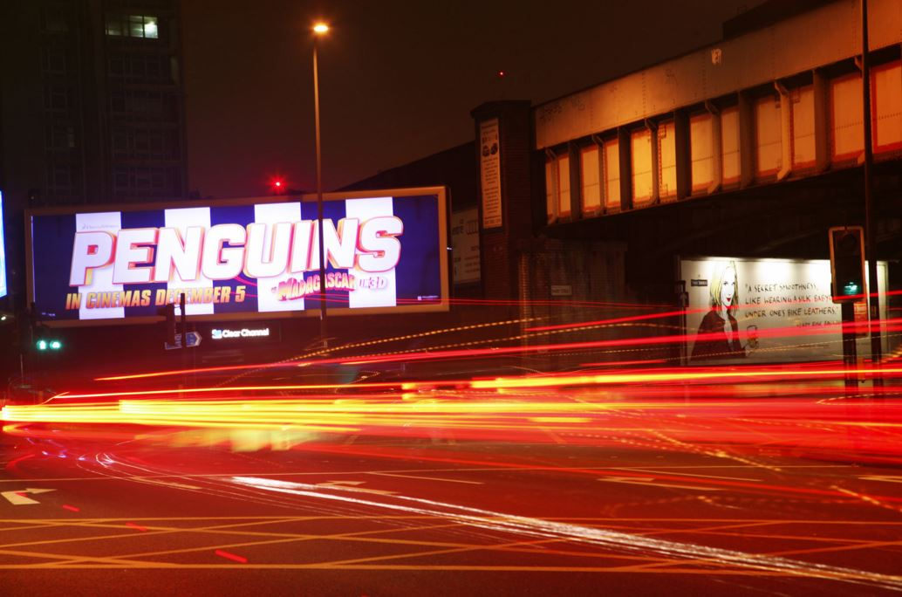
Case study: Penguins of Madagascar
20th Century Fox wanted to create a great sense of excitement to mark their first solo animation film release, Penguins of Madagascar. They set out to achieve this by reminding families about the Penguins and their lovable character as well as heighten their affinity for them.
The interactive campaign encouraged consumers to take a selfie with Penguin, amongst a range of different backgrounds which were reflected back at them on screen. In addition, a personal email was sent to each participant of their chosen images, which could then be shared socially.
The Penguin Selfie campaign was a great success, with a total of 5,218 images taken over 16 days in malls around Manchester, Sheffield, Derby and Dudley. 3,465 personalised Penguin Selfies were sent to consumers throughout the campaign and the overall opt in rate was an impressive 66%.

Slide 3
Outsmart
Third Floor
43 Dorset Street
London W1U 7NA
outsmart.org.uk

