Slide 1
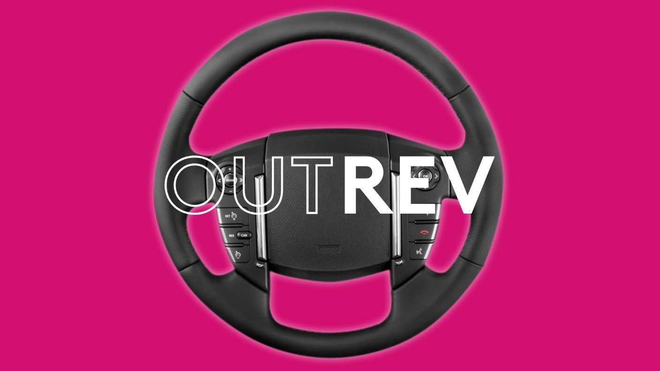

Slide 2
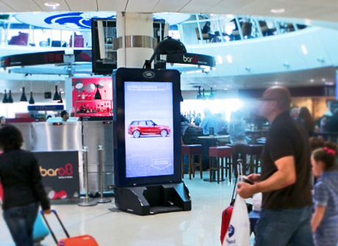
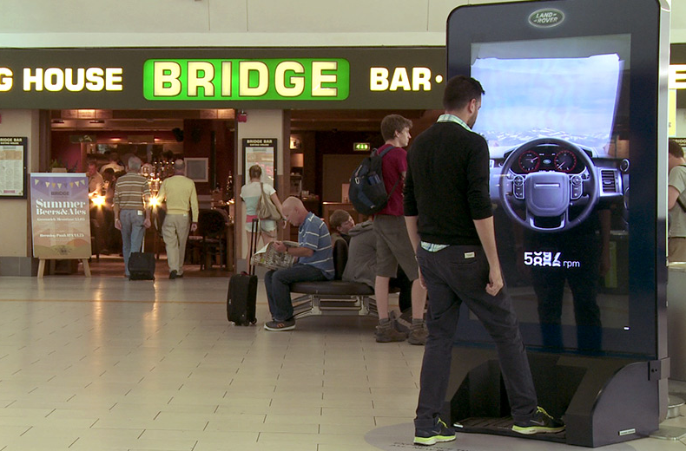
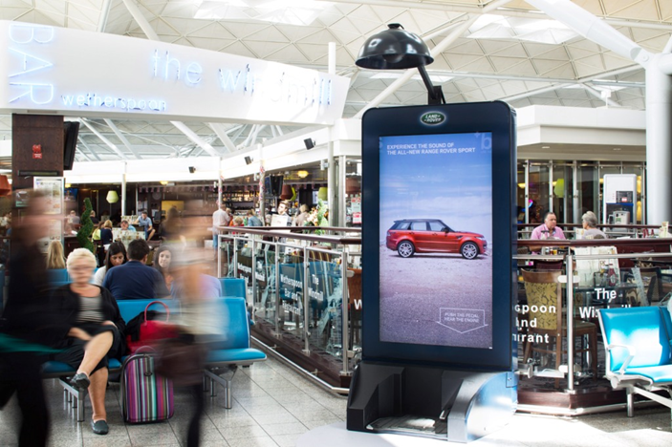
Case study: Range Rover
The launch campaign for the new Range Rover Sport had to reinforce Land Rover’s credentials as a forward-facing brand and deliver real brand appeal. The challenge was to get their ‘Ambitious Aspirers’ target audience to think and feel differently about Land Rover in a new way.
The first OOH interactive installation combining digital and sound was used to enable people to feel the power of the Range Rover Sports’ impressive Supercharged engine. Digital screens were placed at key locations across Gatwick, Stansted and Manchester airports were adapted to include a genuine Range Rover accelerator pedal, with a parabolic directional speaker overhead.
By combining physical elements with technology, the brand was able to deliver a sensorial and realistic experience that mimicked the power of the car.
The results proved that an experience delivered to the right audience in the right location and mind-set can be hugely successful. 40,000 interactions were achieved over the 4 weeks, a staggering 2 interactions per minute.

Slide 3
Outsmart
Third Floor
43 Dorset Street
London W1U 7NA
outsmart.org.uk

