Slide 1
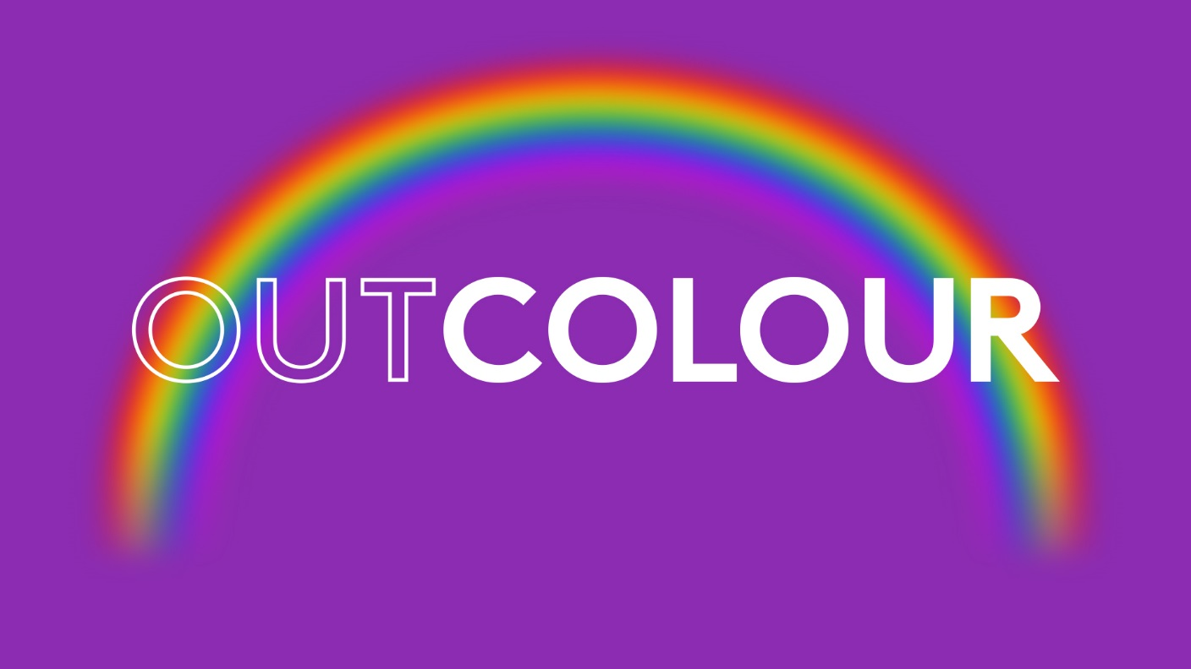

Slide 2
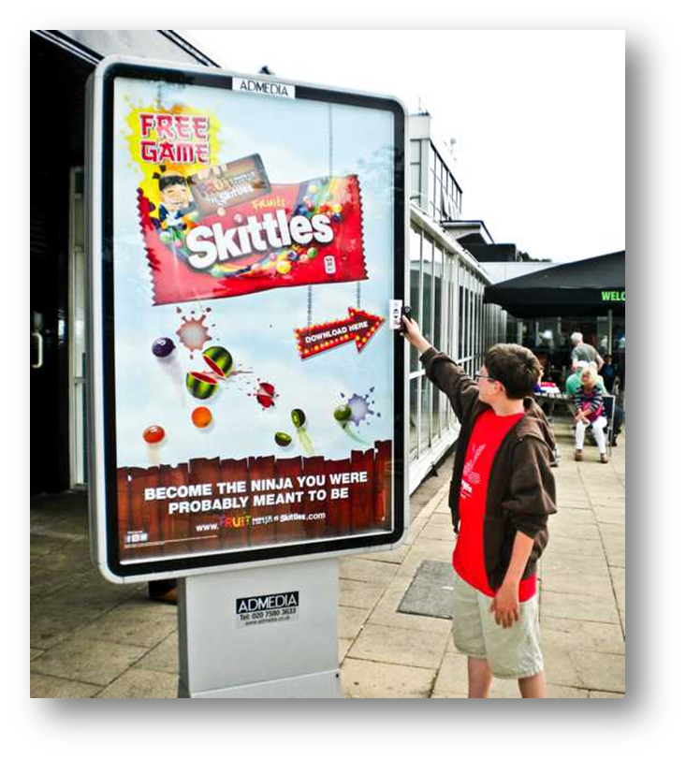
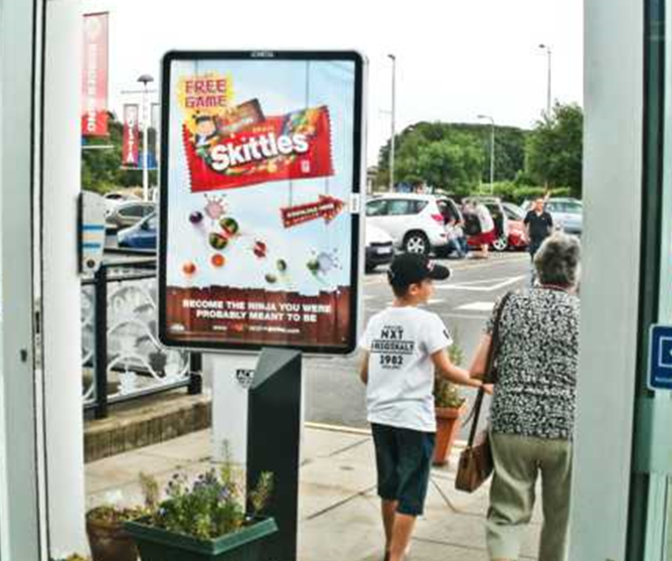
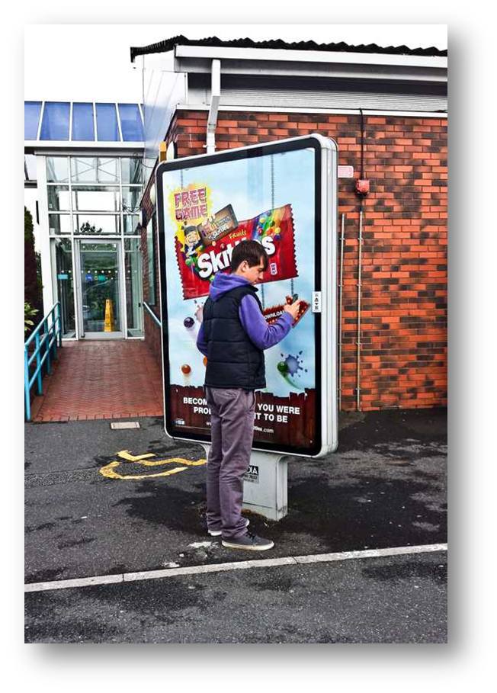
Case study: Skittles
Skittles wanted to raise awareness of their new mobile game ‘Fruit Ninja’. Unmissable 6 sheets were used to target impulse shoppers and encourage interaction with the brand.
NFC and QR technology was utilised to encourage consumers to interact with the game. Over a 2 week period, the poster hit over 18 million individuals, with 113 million impacts.
The results were staggering. 89% of respondents thought the Motorway Service Area was an appropriate place to advertise Skittles. 73% of respondents recalled the Skittles advertisement when prompted. 80% of respondents thought the advertising message was relevant and having an NFC code was an exciting element to the campaign.
60% are more likely to try Skittles, after seeing our poster advertising. EPOS data showed a striking increase of 27% in sales of Skittles for the period of the campaign and remained the highest selling UK confectionary product during this time.

Slide 3
Outsmart
Third Floor
43 Dorset Street
London W1U 7NA
outsmart.org.uk

