Slide 2
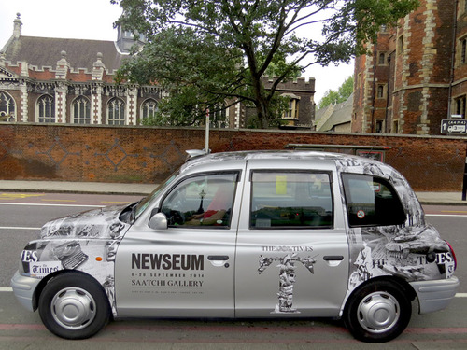
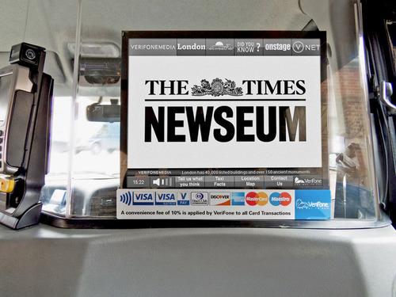
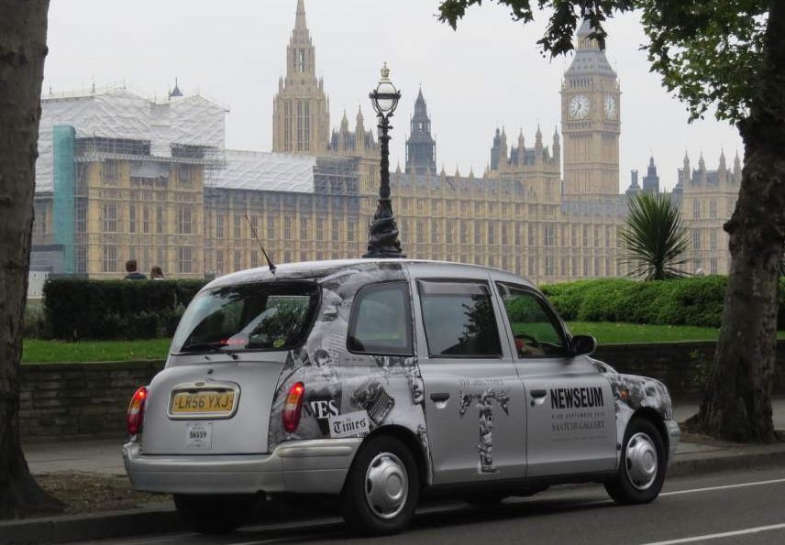
Case study: The Times
The Times needed to drive awareness of, and footfall to, ‘The Newseum’ exhibition held at the Saatchi Gallery in London. As a result, Out of Home was used in a creative way to reach an upmarket, urban audience and create real buzz and anticipation around the exhibition, a journey through the newspaper's history via a collection of priceless artefacts and documents from The Times archive.
Geo-targeted digital screens, liveries and in-cab NFC tags ran for a two-week period across VeriFone Media Taxis, using sophisticated technology that detects when a taxi enters a specific area of London in close proximity to the Saatchi Gallery where the Newseum exhibition is showing.
In total 95,969 impacts were delivered exclusively in the London areas closest to the exhibition; namely Chelsea and Knightsbridge. The media value generated was approximately £80k, giving The Times a phenomenal 700% return on their investment. 60% of those surveyed showed definite interest in attending the Saatchi Gallery exhibition.

Slide 3
Outsmart
Third Floor
43 Dorset Street
London W1U 7NA
outsmart.org.uk

