Slide 1
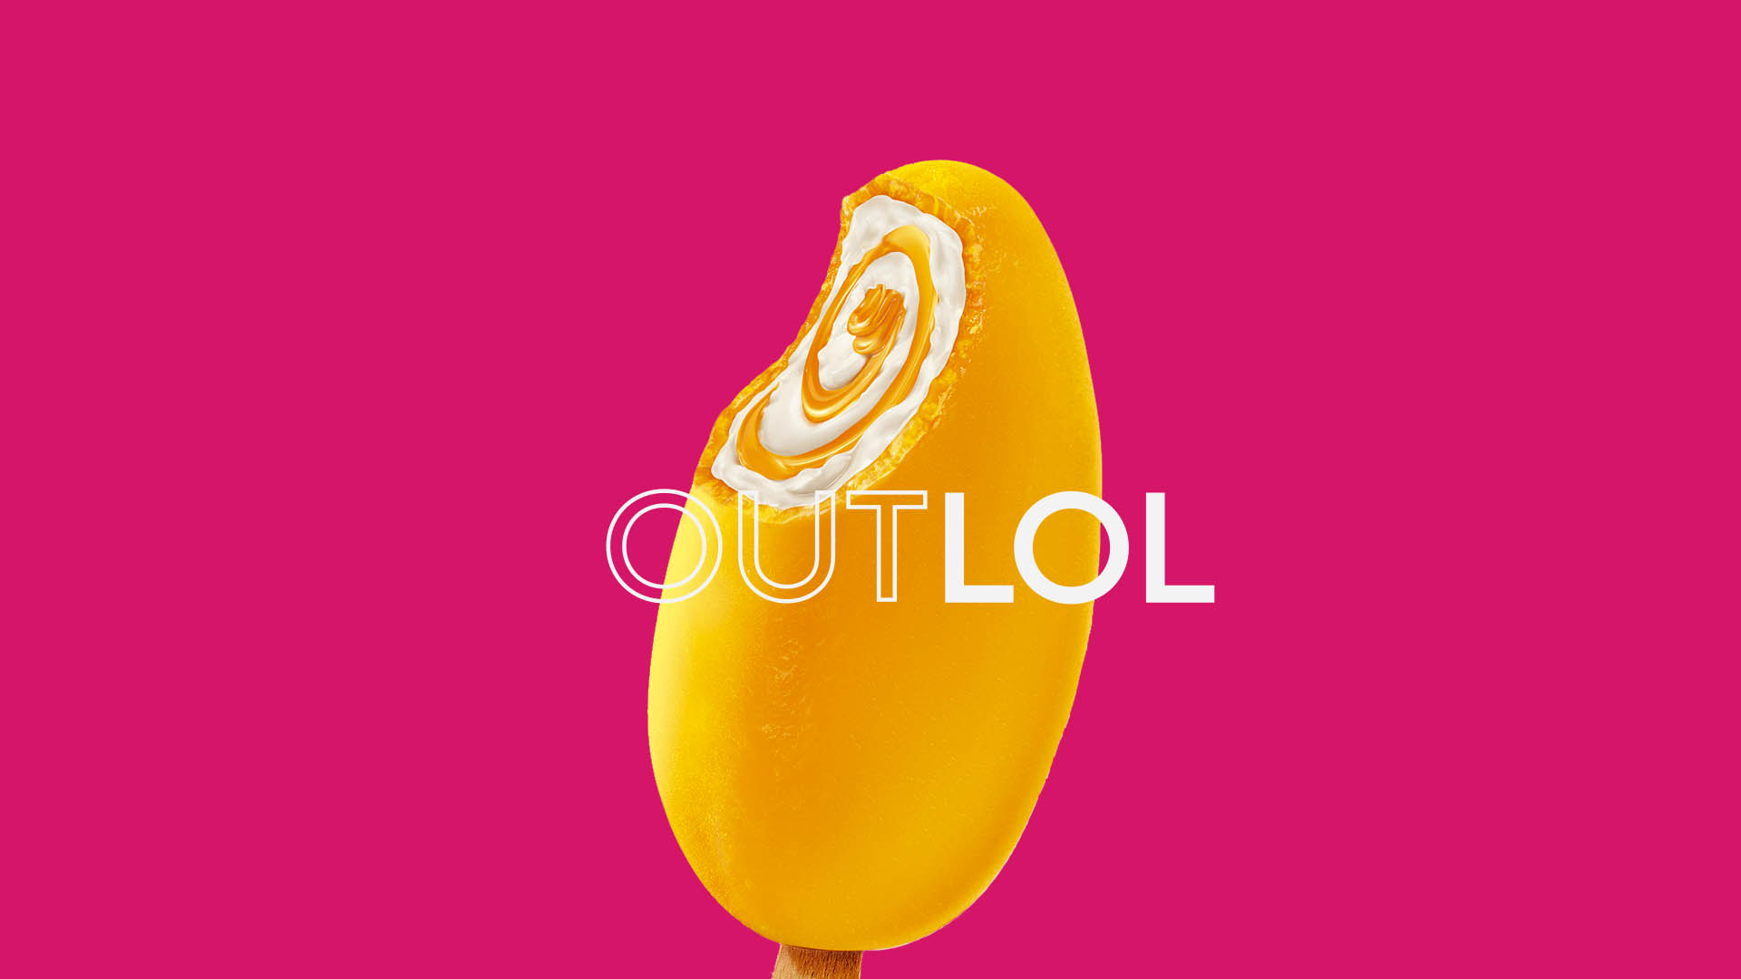

Slide 2
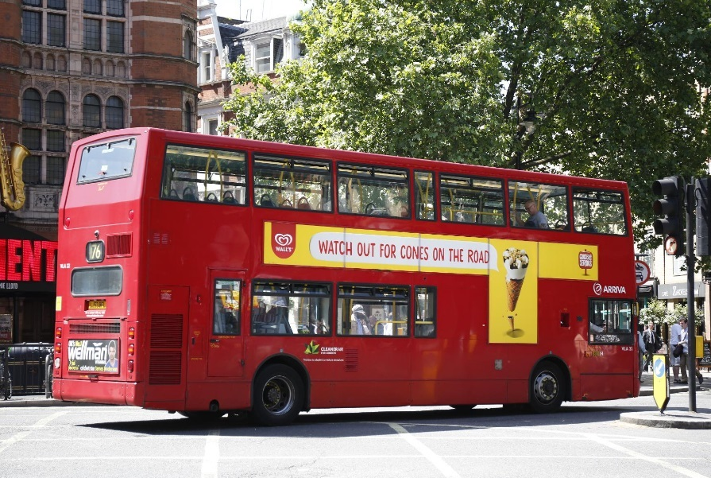
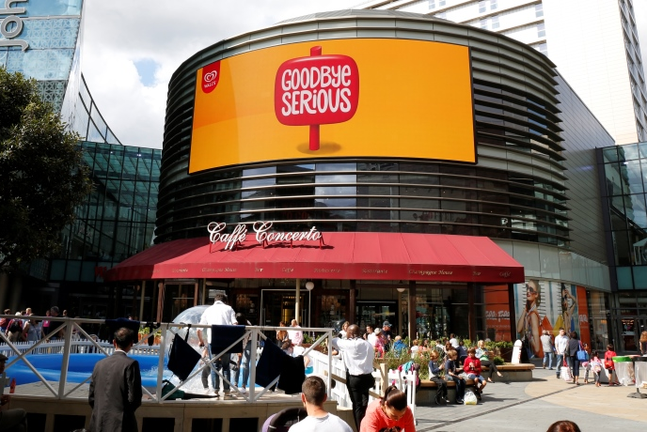
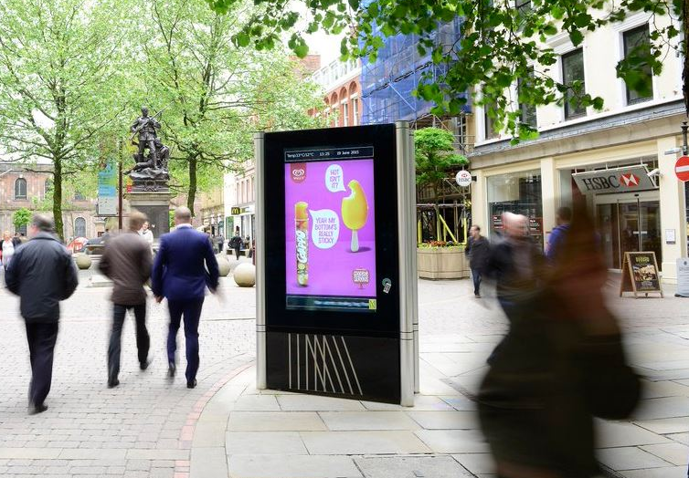
Case study: Wall’s
Wall’s much loved classics; Twisters, Soleros, Cornettos have faced heavy competition through the years. This led to a loss in relevance and market share for Walls.
The ‘Goodbye Serious’ campaign had to reignite the consumers childlike love for ice cream. It was achieved through social channels and OOH so whenever the sun was out they had something to say. The high temperatures triggered the OOH ads that kept Wall’s ice cream front of mind all summer long. Over the course of the campaign there was 60 different creatives, this ensured the ads were always contextually relevant.
The ‘Goodbye Serious’ campaign resulted in a growth uplift of 70%. The campaign sold 1.3 million ice creams during the summer of 2014. Wall’s reclaimed its status as a brilliantly British ice-cream and connected with a new generation of young adults.

Slide 3
Outsmart
Third Floor
43 Dorset Street
London W1U 7NA
outsmart.org.uk

