Slide 1



Slide 2
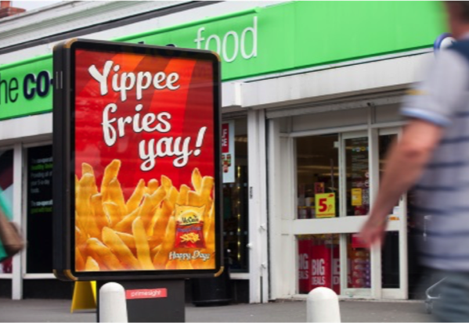
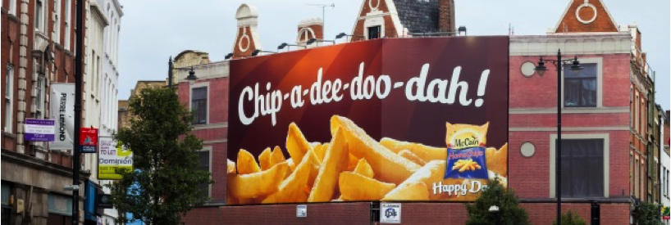
Case study: McCain
After overhauling the brand, McCain wanted to make a big impression in order to drive sales and convince people to make McCain their first choice when buying frozen potato products. To do this, McCain sought to make the brand synonymous with “happy days”.
Out of home media was used as a part of a larger campaign to dominate the high street, creating a sense of ubiquity and ensuring the brand was front of mind. The campaign reached over 90% of the UK population by using a combination of bus supersides, 6-sheets and 48-sheets nationwide, and premium digital screens in key cities.
Following the campaign, brand recall rose 15 points above UK norms, a significant increase over previous results, to help cement the link between the brand and its new positioning.

Slide 3
Outsmart
Third Floor
43 Dorset Street
London W1U 7NA
outsmart.org.uk

