Slide 1

The Customer Journey
Research by Outsmart
July 2011

Slide 2
The Last Window of Influence (July 2011):
Research Objectives
To understand which media shoppers experience in the 30 minute build up to a shopping experience
To establish the recency of ad exposures
To understand how people shop
To gauge the potential for shoppers to be influenced by poster advertising
To study the above by retailer group

Slide 3
Research Methodology
Helen Harrison Research for fieldwork
604 face to face ‘intercept’ interviews with shoppers
In street/entrance to malls, 4 locations to represent geographical region, shopping environment and day of week
Gender and age group targets
Quotas for retailers to be visited
Fieldwork: 2nd July – 16th July 2011

Slide 4
Research Methodology
In street ‘intercept’
  Neutral zones – not in station, bus shelter but close to transport hubs to sample respondents as they arrived.
  Interviewers rotated around zones to achieve retail quotas as well as all modes of transport.
At malls
  Entrances – all footfall patterns, modes of transport
Weekday/Weekend, All dayparts: 9:30am – 8pm
  Showcards to illustrate and clarify all media types and advertising environments – Outdoor, Web and mobile, press, magazines, radio

Slide 5
Sample Design
 | Location 1 |  | Location 2 |  | Location 3 |  | Location 4
 | North |  | North |  | London & SE |  | London
 | Manchester Arndale Centre |  | Leeds White Rose Shopping Centre |  | Croydon |  | Westfield
Location Type: | High Street and City Centre Shopping |  | Out of Town Shopping Mall |  | High Street and Shopping Centre |  | City Centre Shopping Mall
Day of Week: | Weekend |  | Weekday |  | Weekday |  | Weekend
 | Male | Female | Male | Female | Male | Female | Male | Female
Total sample: | 75 | 75 | 75 | 75 | 75 | 75 | 75 | 75
16 - 24 | 15 | 15 | 15 | 15 | 15 | 15 | 15 | 15
25 - 34 | 15 | 15 | 15 | 15 | 15 | 15 | 15 | 15
35 - 44 | 15 | 15 | 15 | 15 | 15 | 15 | 15 | 15
45 - 54 | 15 | 15 | 15 | 15 | 15 | 15 | 15 | 15
55+ | 15 | 15 | 15 | 15 | 15 | 15 | 15 | 15
Total: | 150 |  | 150 |  | 150 |  | 150
 | 600+

Slide 6
Retail Destinations of Shoppers
Additional Quotas to achieve target sample minimum 100 visitors/intend to purchase at each of the following retail outlets:
 | Sample Achieved
Fashion /clothes | 437
Fast Food | 248
Banks / building societies - cashpoint | 210
Chemists | 196
Telecom /mobile phone | 190
Supermarket | 184
Newsagent/CTN | 133
Travel Agents - currency exchange | 86

Slide 7
Shoppers’ Modes of Transport by Location
Modes of transport vary significantly by location
Base: All Shoppers (604)

Slide 8
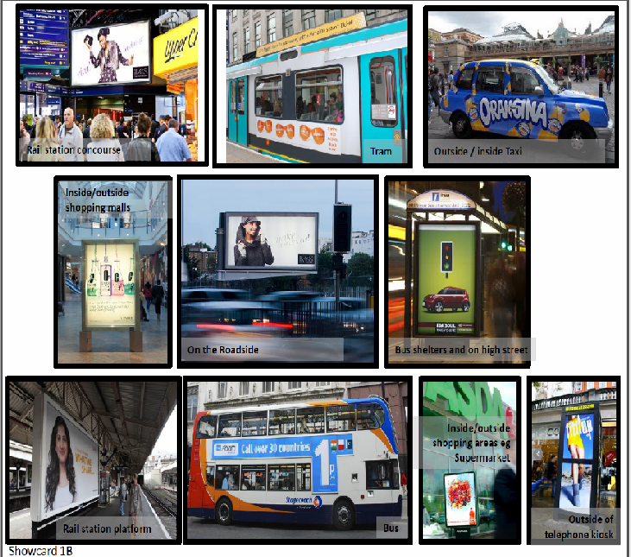
Out of Home showcard (London)
Seen / heard in last 30 minutes
Seen / heard in last 24 hours
Seen / heard during past week
Seen / heard longer ago
Source: Helen Harrison Associates, July 2011, 604 intercept shopper interviews, 4 UK locations

Slide 9
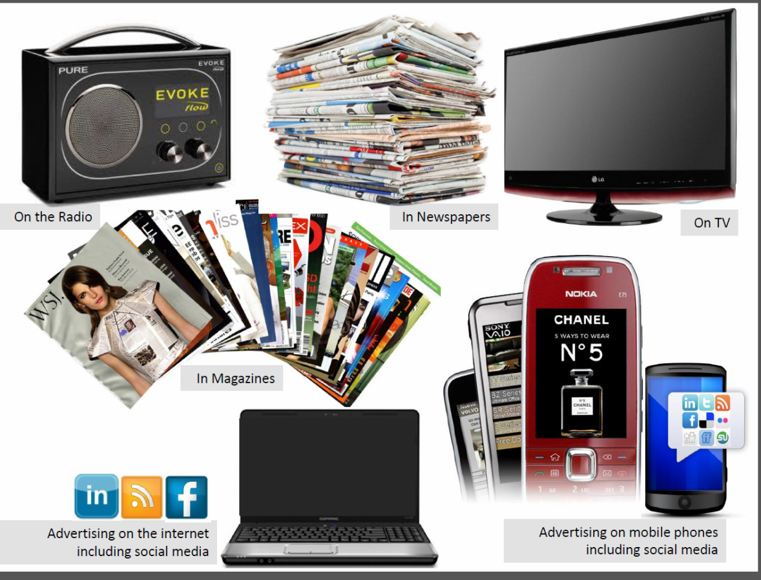
Other media showcard
Seen / heard in last 30 minutes
Seen / heard in last 24 hours
Seen / heard during past week
Seen / heard longer ago
Source: Helen Harrison Associates, July 2011, 604 intercept shopper interviews, 4 UK locations

Slide 10
Any Ad Recall vs 30 mins Ad Recall by Media ‘The Last Window of Influence’
All Shoppers
Source: Helen Harrison Associates, July 2011, 604 intercept shopper interviews, 4 UK locations

Slide 11
30 mins Ad Recall by Media ‘The Last Window of Influence’
Base: All aware any advertising any media last 30 mins (274)

Slide 12
Shoppers’ ad exposure in 30 min. preceding start of shopping (“last window of influence”)
(N=274)
12%
88%
Source: Helen Harrison Associates, July 2011, 604 intercept shopper interviews, 4 UK locations

Slide 13
Seen Out of Home ad in past 30 mins
Source: Helen Harrison Associates, July 2011, 604 intercept shopper interviews, 4 UK locations

Slide 14
The Out of Home Ad Aware 30 minutes Shopper - Likelihood to Visit Retailers
 | INDEX vs. All Shoppers
Mobile phone / telecom stores | 112
Banks / building society | 111
Fast Food outlet | 111
News agent / convenience store | 110
Fashion/clothes shops | 98
Supermarket | 97
Chemist | 91
Travel Agents | 85
Base: Outdoor Ad Aware 30 mins (240)

Slide 15
Visitors to Mobile phone / telecom stores: 45% have seen Out of Home ads in past 30 minutes
Base: All Shoppers (n=604), those intending to visit mobile phone store today (n=190)
Source: Last Window of Influence, Helen Harrison Associates, face to face intercept interviews, 4 UK shopper locations, July 2011

Slide 16
Visitors to fast food stores – 45% have seen Out of Home ads in past 30 minutes
Base: All Shoppers (n=604), those intending to visit fast food store today (n=249)
Source: Last Window of Influence, Helen Harrison Associates, face to face intercept interviews, 4 UK shopper locations, July 2011

Slide 17
Visitors to supermarkets – 39% have seen Out of Home ads in past 30 minutes
Base: All Shoppers (n=604), those intending to visit supermarket today (n=184)
Source: Last Window of Influence, Helen Harrison Associates, face to face intercept interviews, 4 UK shopper locations, July 2011

Slide 18
Visitors to banks / building societies: 44% have seen Out of Home ads in past 30 minutes
Base: All Shoppers (n=604), those intending to visit bank / building society today (n=210)
Source: Last Window of Influence, Helen Harrison Associates, face to face intercept interviews, 4 UK shopper locations, July 2011

Slide 19
Visitors to fashion and clothes shops: 39% have seen Out of Home ads in past 30 minutes
Base: All Shoppers (n=604), those intending to visit fashion and clothes shop today (n=437)
Source: Last Window of Influence, Helen Harrison Associates, face to face intercept interviews, 4 UK shopper locations, July 2011

Slide 20
Visitors to chemists – 36% have seen Out of Home ads in past 30 minutes
Base: All Shoppers (n=604), those intending to visit chemist today (n=196)
Source: Last Window of Influence, Helen Harrison Associates, face to face intercept interviews, 4 UK shopper locations, July 2011

Slide 21
Visitors to newsagent / convenience store: 44% have seen Out of Home ads in past 30 minutes
Base: All Shoppers (n=604), those intending to visit newsagent / convenience store today (n=133)
Source: Last Window of Influence, Helen Harrison Associates, face to face intercept interviews, 4 UK shopper locations, July 2011

Slide 22
Visitors to travel agents: 34% have seen Out of Home ads in past 30 minutes
Base: All Shoppers (n=604), those intending to visit travel agent store today (n=86)
Source: Last Window of Influence, Helen Harrison Associates, face to face intercept interviews, 4 UK shopper locations, July 2011

Slide 23
Impact of Out of Home – Likelihood to buy increases if OOH seen in past 30 minutes
 | All Shoppers (604) | OOH Ad Aware (241) | INDEX
Poster might make you more likely to consider finding out more about the product/brand | 64% | 72% | 114
Poster might make you more likely to buy the product/brand | 53% | 59% | 112

Slide 24
Retail Visitors – Out of Home in last window of Influence has potential to be highly effective
 | % More likely to find out more about a brand having seen OOH in past 30 mins | % More likely to buy having seen OOH in past 30 mins
Chemist | 81% | 56%
Newsagent / convenience store | 75% | 55%
Mobile phone / telecom stores | 74% | 71%
Fashion/clothes shops | 69% | 62%
Fast Food outlet | 69% | 51%
Supermarket | 68% | 60%
Banks / building society | 67% | 65%

Slide 25
Attitudes to Shopping: only 13% not susceptible to last window of influence
 | All Shoppers (604) | 16-44 (366) | Men (294) | Women (310)
I usually plan in advance everything I want to buy and only buy things on my list | 13% | 9% | 17% | 8%
I sometimes make unplanned purchases but mostly stick to my shopping list | 29% | 26% | 28% | 30%
I often buy something that's not on my shopping list | 18% | 21% | 16% | 20%
I usually don’t make a shopping list or plan, and just buy spontaneously | 39% | 43% | 37% | 41%

Slide 26
Summary – Out of Home Key Points
Out of Home is the key medium to reach shoppers in the 30 minutes prior to purchase. 40% of shoppers see outdoor in the last window of influence. Next highest is radio with 8%
Out of Home dominates ad exposure in last 30 minutes, reaching 88% of those exposed to any ad
Only 13% of adults not susceptible to last minute influence, and only 8% of women and 9% of 16-44’s
Awareness of Out of Home advertising during this pre purchase period increases the likelihood to find out more about a product and to buy a product

