Slide 1

YouGov Public perceptions
August 2012

Slide 2
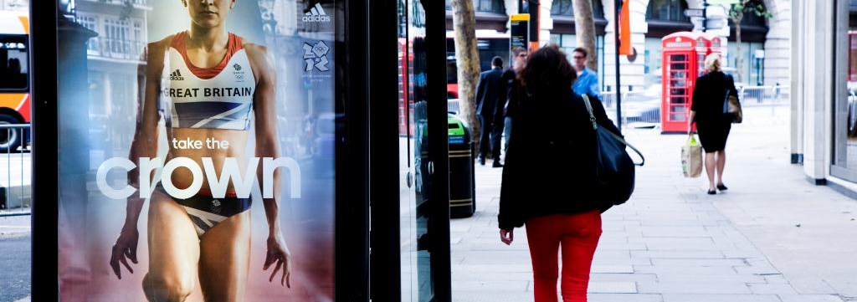
Out of Home advertising can give advertisers strong links with sporting events
Out of Home advertising helped make London 2012 the greatest show
on earth.
56% of Games visitors think that OOH advertising is a good way for advertisers to show their links with large sporting events and festivals.
Source: YouGov 2012

Slide 3
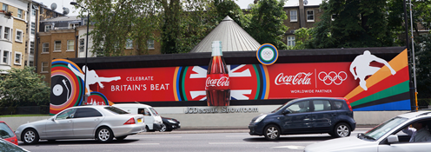
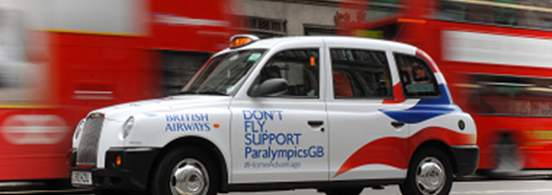
Out of Home gets noticed
62% of Games visitors noticed Out of Home advertising during the Games.
The advertising dominated buses, taxis, and shopping malls, roadside, rail and Underground
62% of Games visitors noticed Outdoor advertising during the Games.
The advertising dominated buses, taxis, and shopping malls, roadside, rail and Underground
Source: YouGov 2012

Slide 4
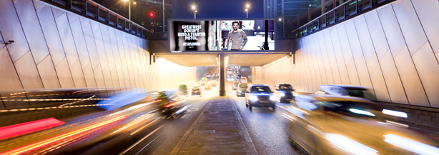
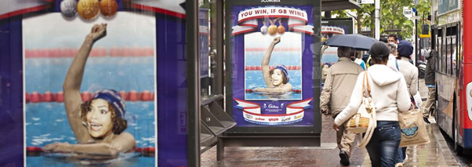
Out of Home adds colour and vibrancy
52% of Games visitors thought the OOH advertising added colour and vibrancy to the Games
OOH was at the forefront of the Games, spreading Olympic fever with colourful wraps, large scale buildings and even painted turf.
Source: YouGov 2012

Slide 5
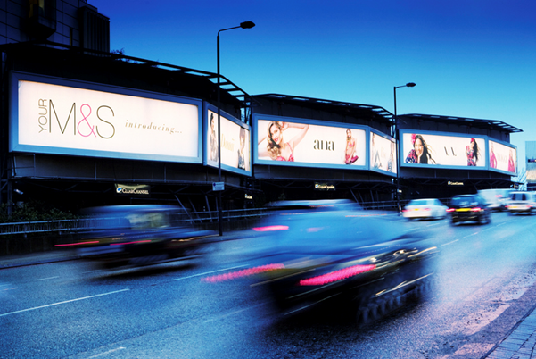
Retail campaigns get noticed with Out of Home
“Have you seen OOH advertising for any retailers recently?”
Urban means people who live, work or study in a large town or city
Source: YouGov, August 2012

Slide 6
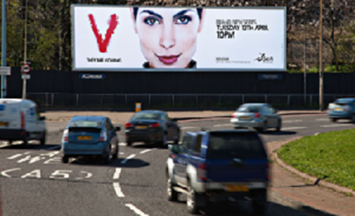
Entertainment campaigns get noticed with Out of Home
“Have you seen OOH advertising for new films, theatrical shows, books or music recently?”
Urban means people who live, work or study in a large town or city
Source: YouGov, August 2012

Slide 7
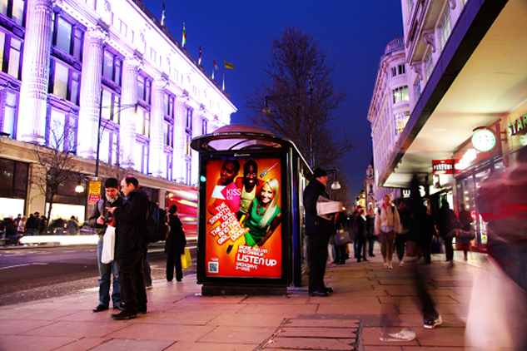
TV, radio and newspaper campaigns get noticed with Out of Home
“Have you seen OOH advertising for TV, radio, or newspapers recently?”
Urban means people who live, work or study in a large town or city
Source: YouGov, August 2012

Slide 8
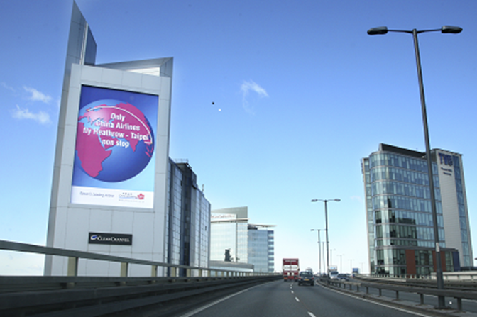
Travel and holiday destinations campaigns get noticed with Out of Home
“Have you seen OOH advertising for travel and holiday destinations recently?”
Urban means people who live, work or study in a large town or city
Source: YouGov, August 2012

Slide 9
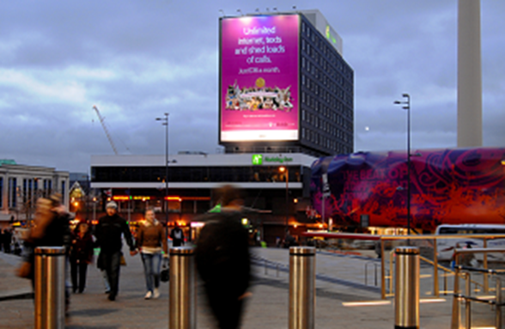
Mobile phone and handset campaign get noticed with Out of Home
“Have you seen OOH advertising for mobile phone handsets recently?”
Urban means people who live, work or study in a large town or city
Source: YouGov, August 2012

Slide 10
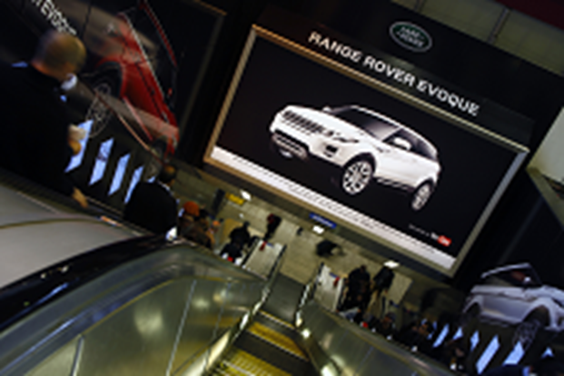
Car brand campaigns get noticed with Out of Home
“Have you seen OOH advertising for car brands recently?”
Urban means people who live, work or study in a large town or city
Source: YouGov, August 2012

Slide 11
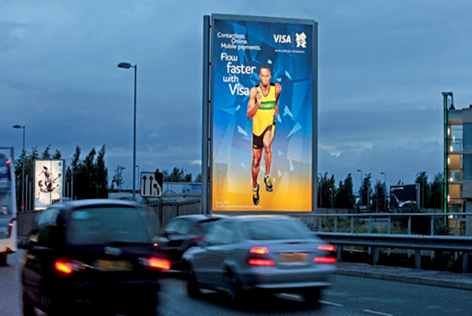
Banks and financial services campaigns get noticed with Out of Home
“Have you seen OOH advertising for banks and financial services recently?”
Urban means people who live, work or study in a large town or city
Source: YouGov, August 2012

Slide 12
The public has a positive attitude to posters: latest scores from Aug 2012

Slide 13
Young people are positively disposed to posters: latest scores from Aug 2012

Slide 14
Urban dwellers are positively disposed to posters: latest scores from Aug 2012
Urban means live, work or study in a large town or city
Source: YouGov, August 2012

Slide 15
Connected people are positively disposed to posters: latest scores from Aug 2012
*Connected means owning either a smart phone or a tablet

Slide 16
YouGov research: public attitude to posters
*Connected means owning either a smart phone or a tablet
*Urban means live, work or study in a large town or city
Source: YouGov, August 2012

